Slide 1
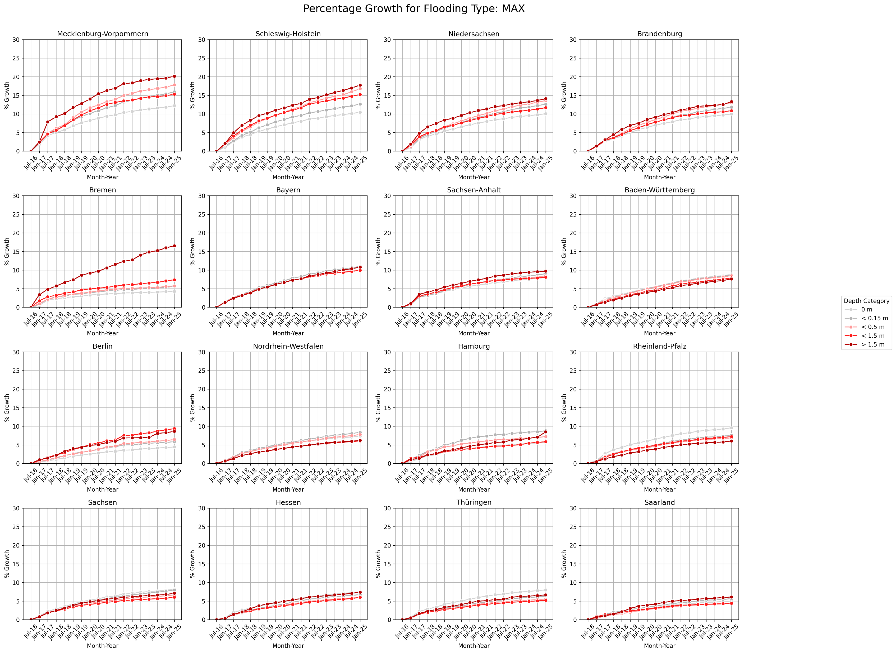

Slide 2
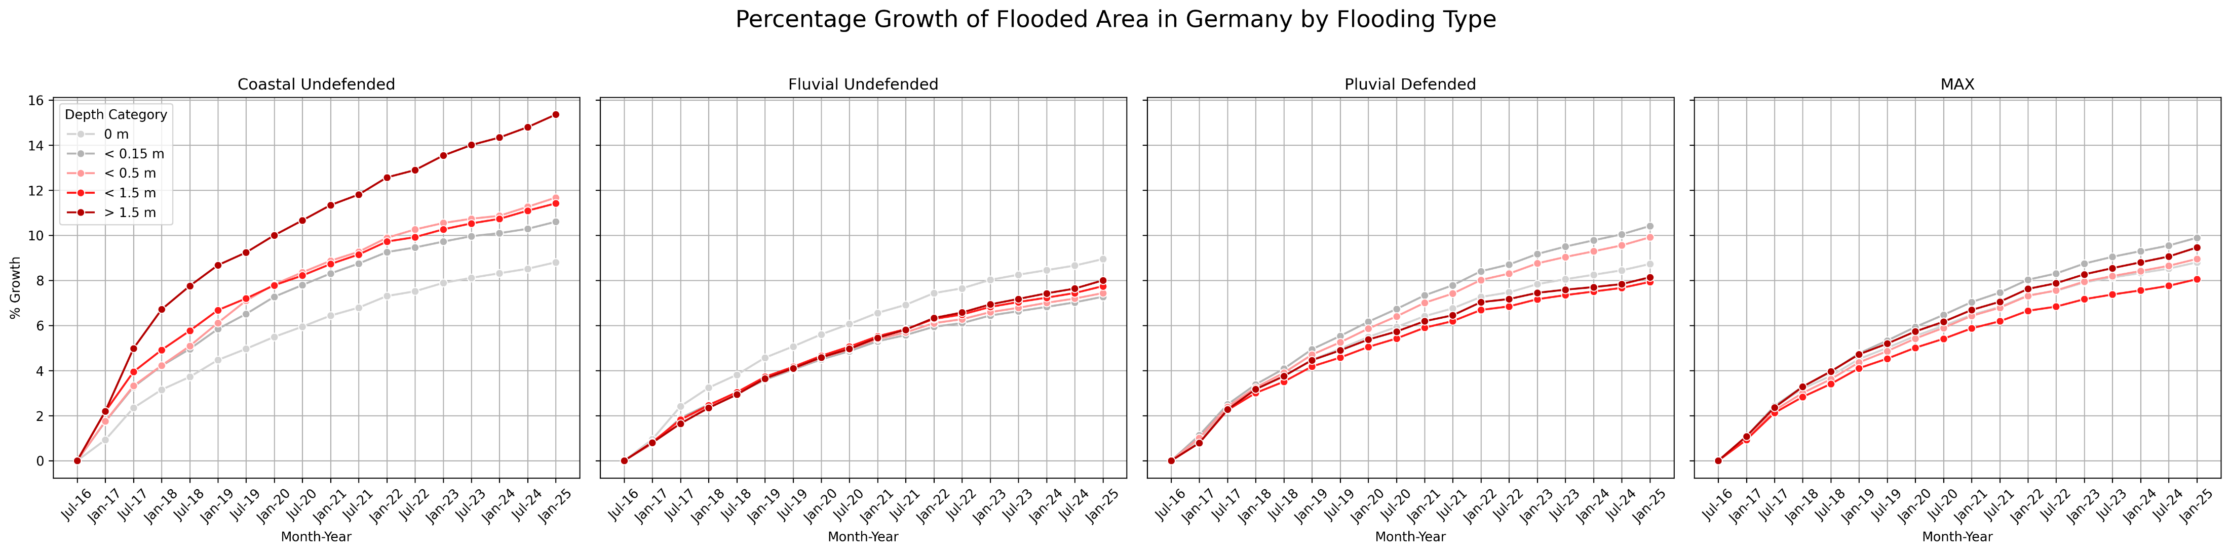

Slide 3
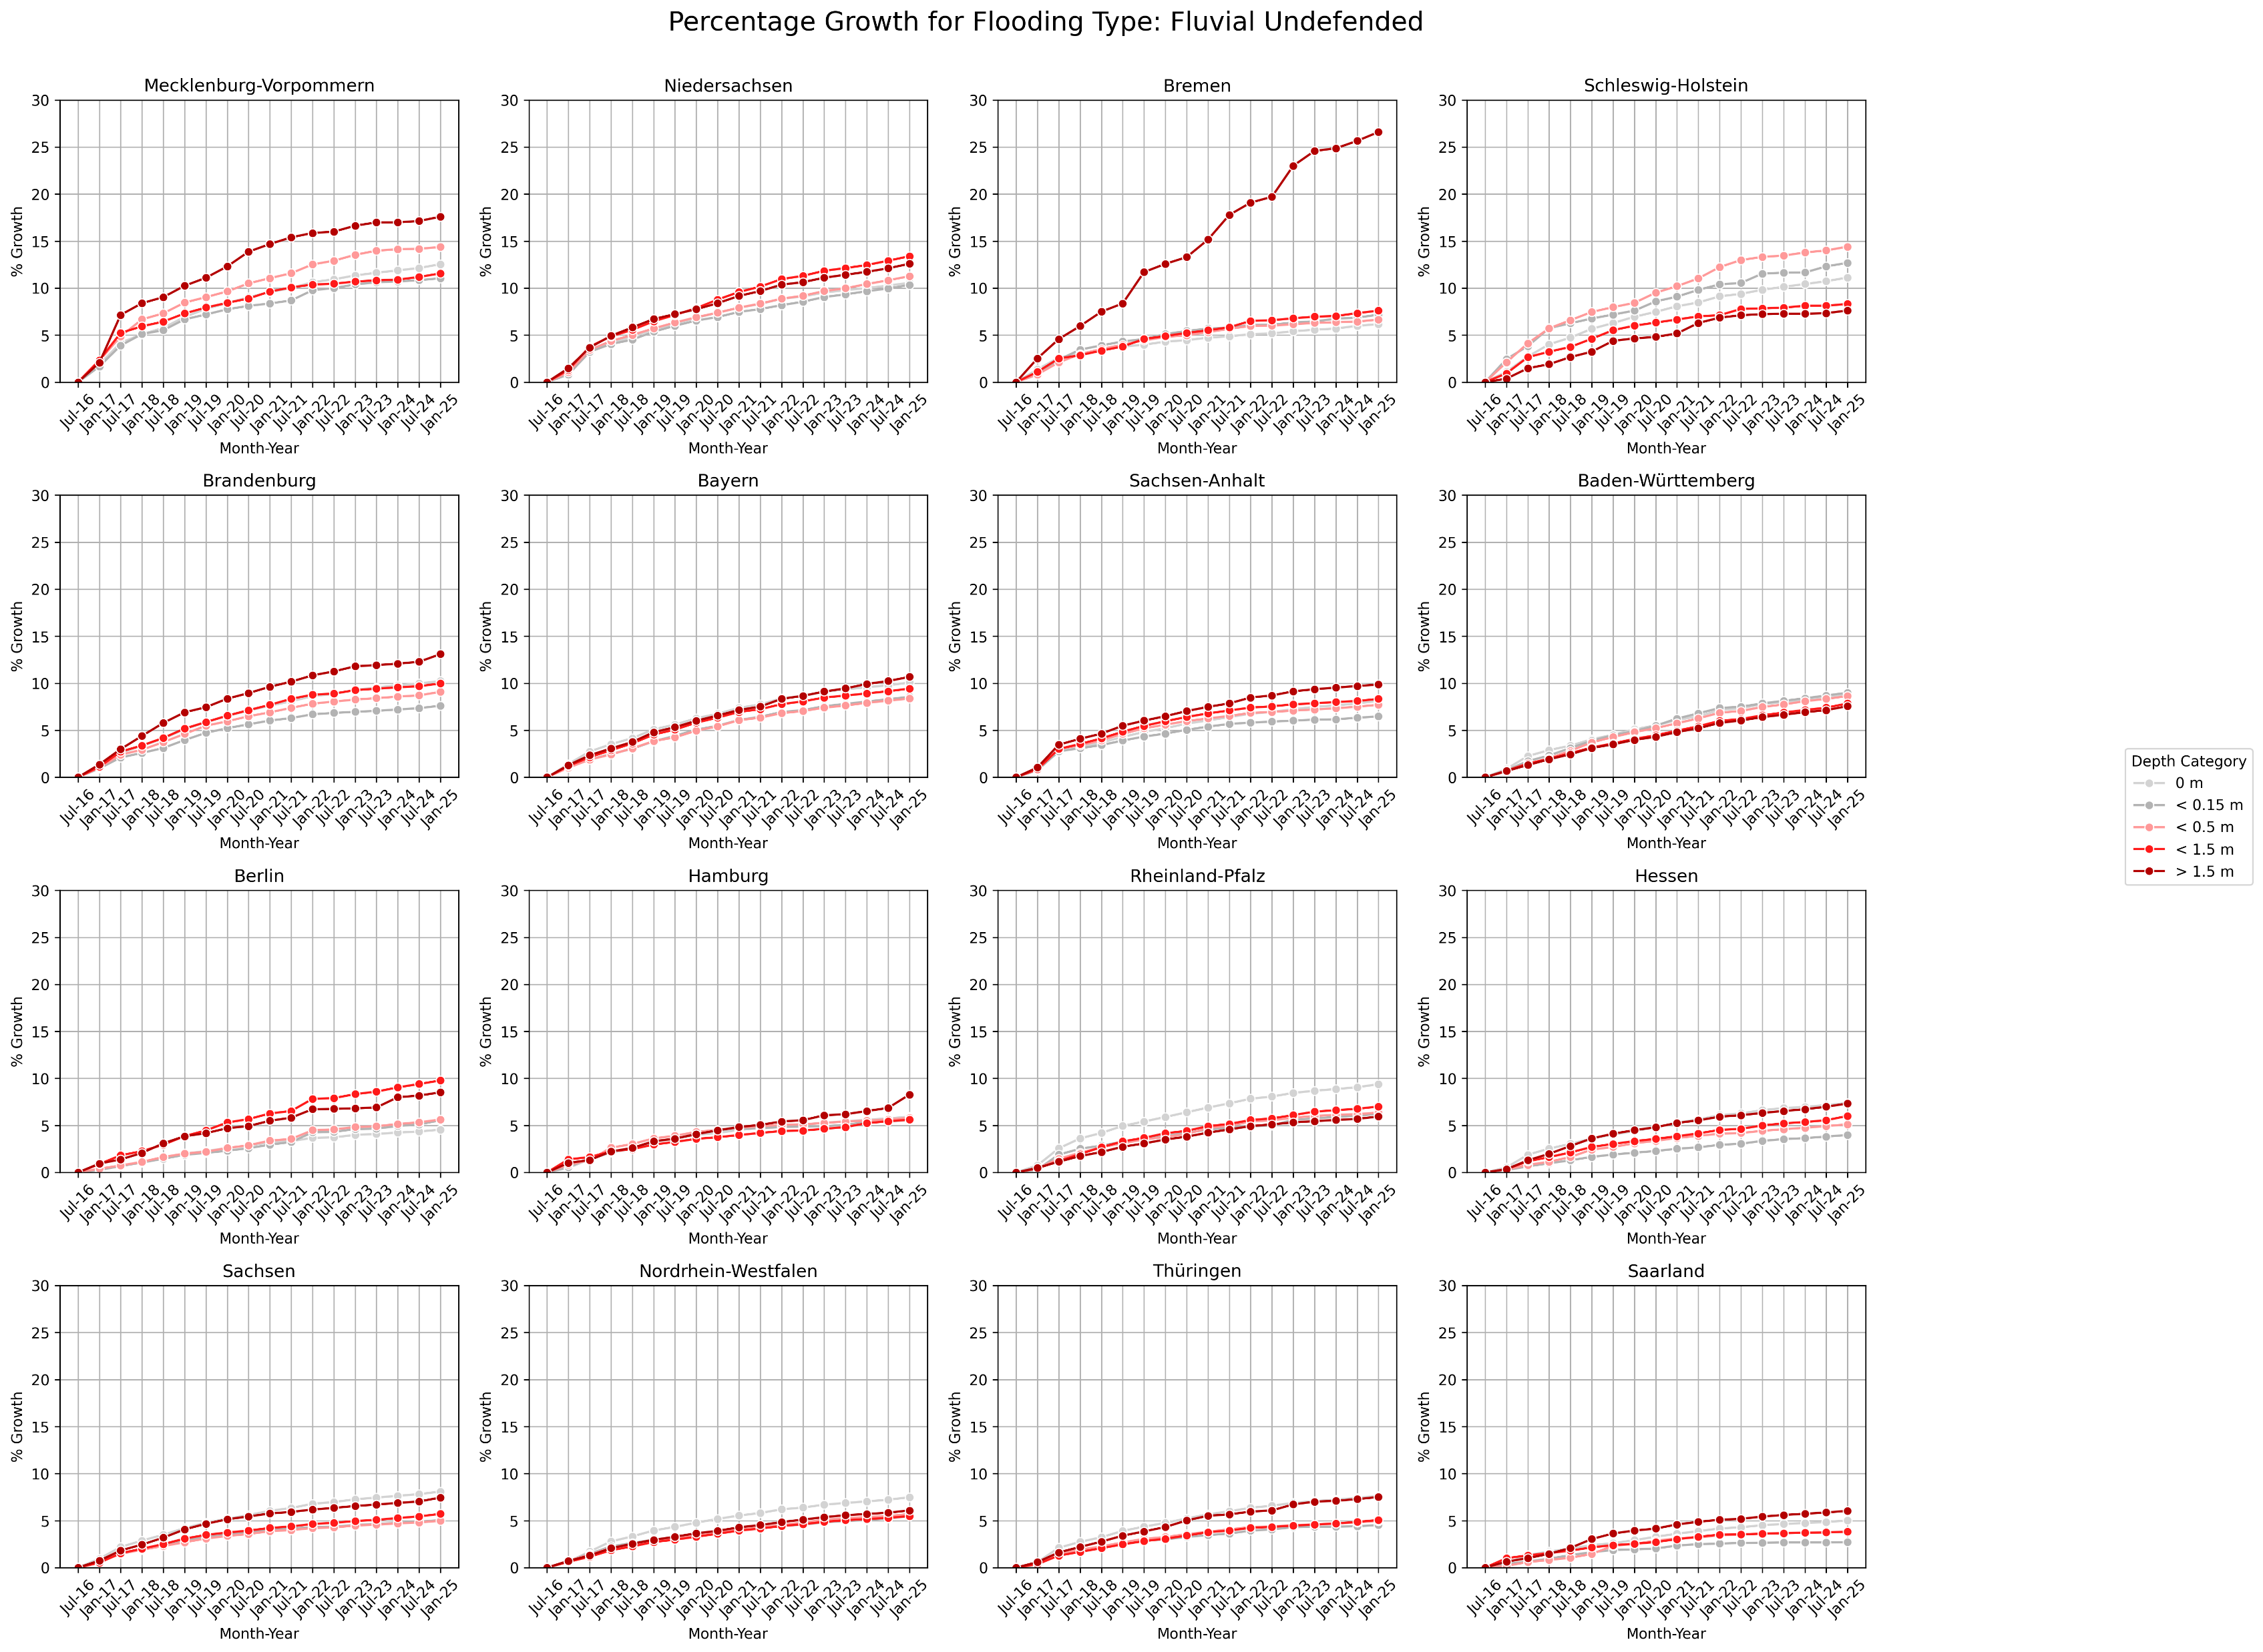

Slide 4
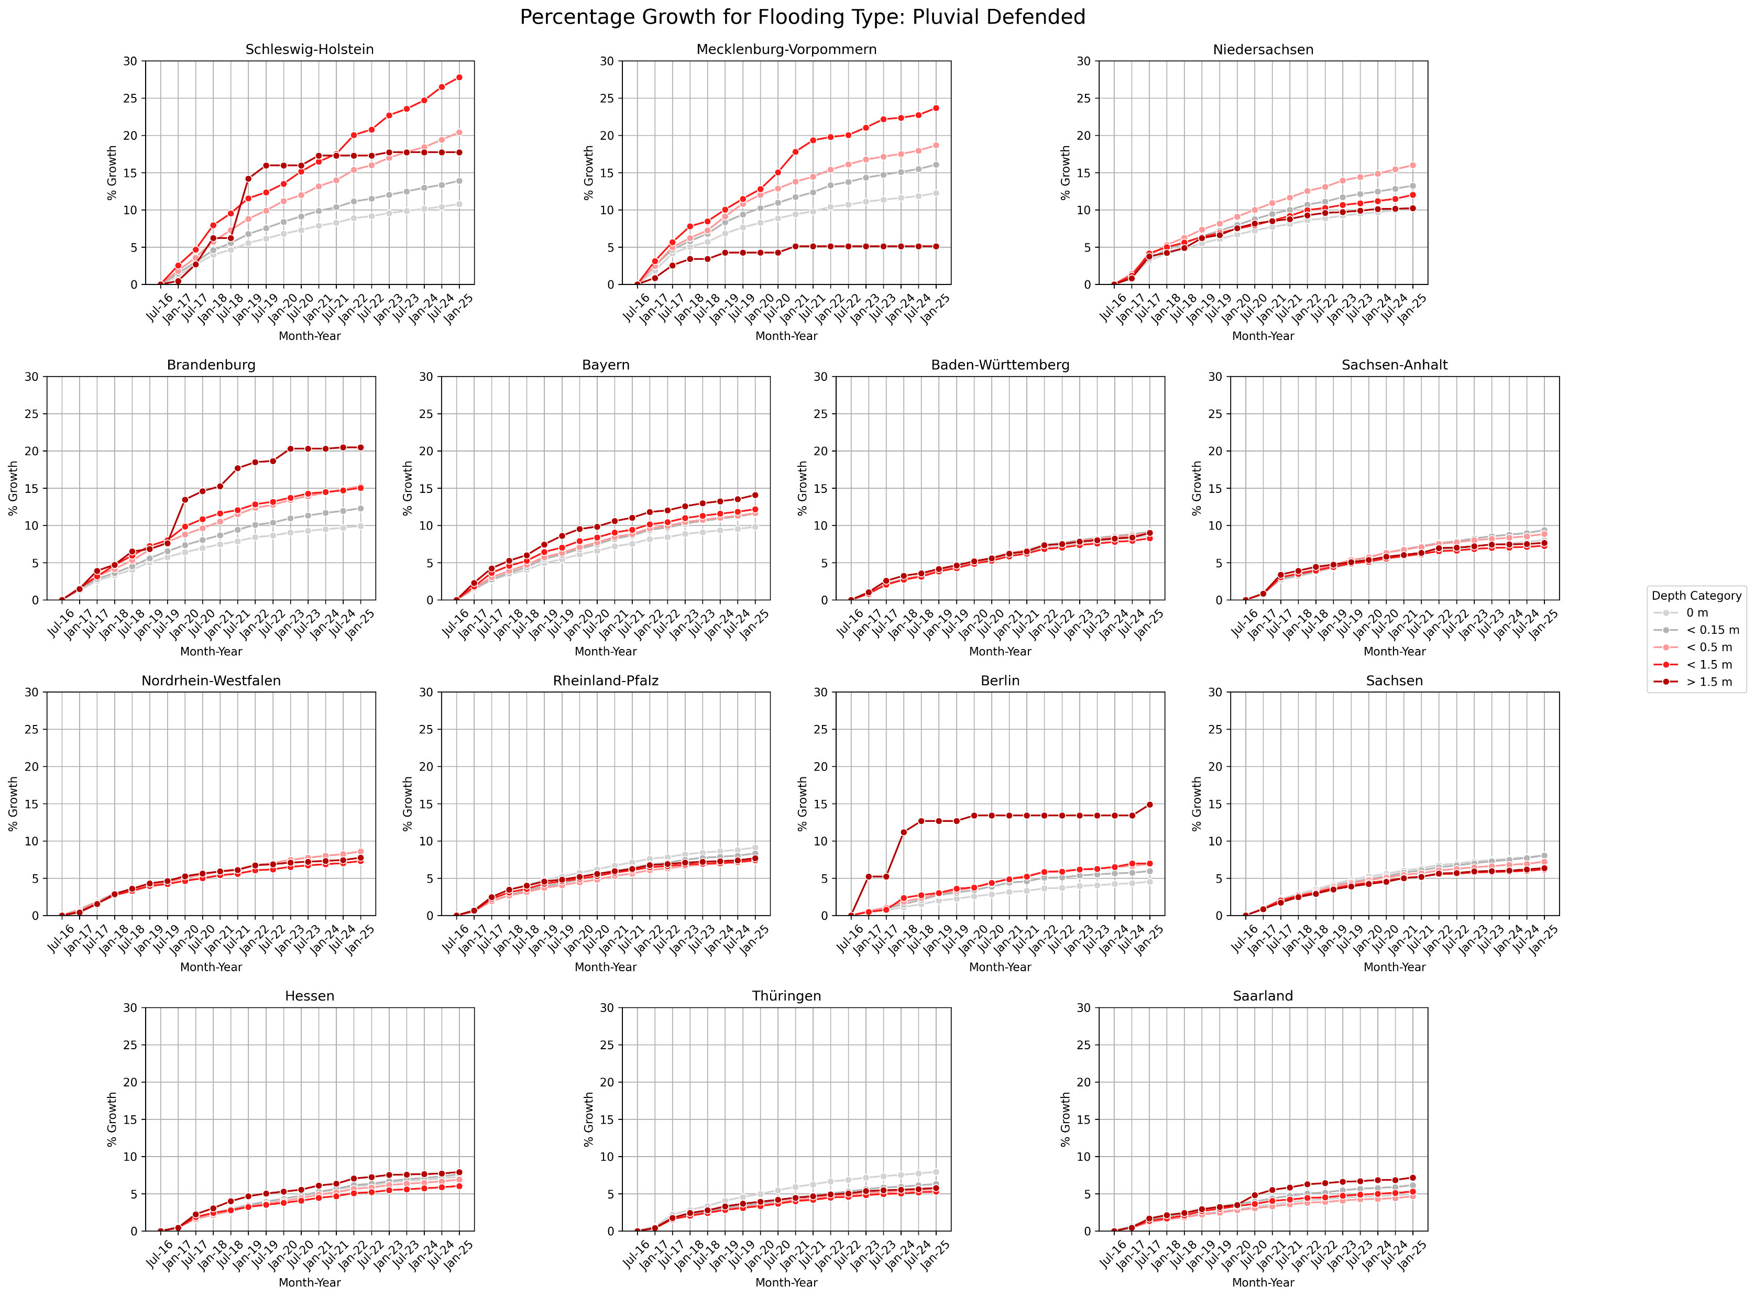

Slide 5
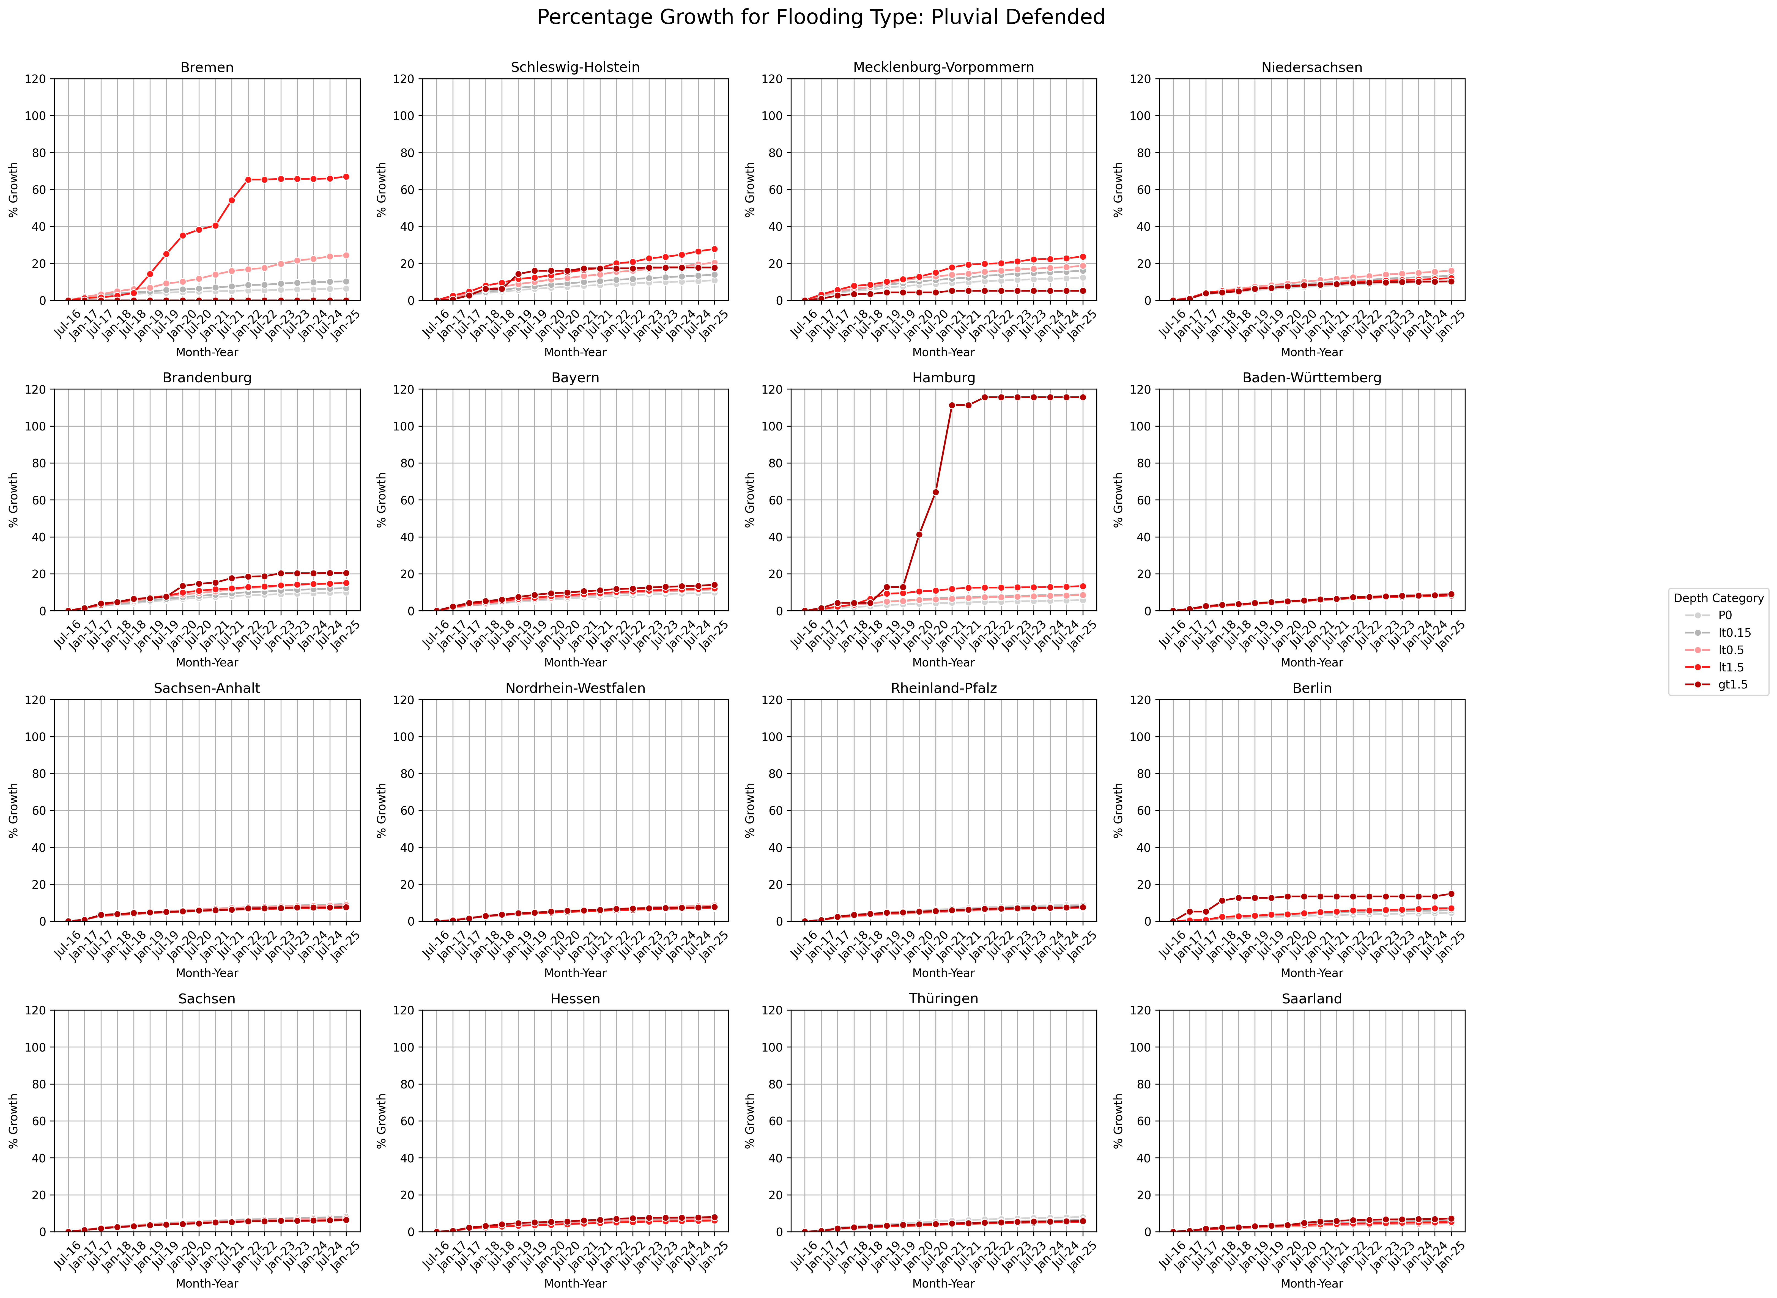
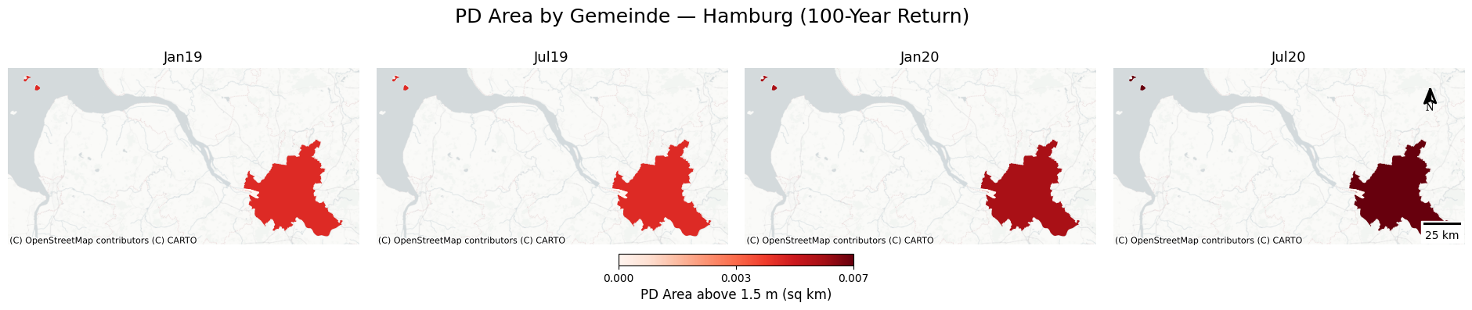
Hamburg is not included in the percentage growth of settlement area under the pluvial flooding scenario, as only a small area experienced a substantial percentage increase in flooding depth exceeding 1.5 meters.

Slide 6
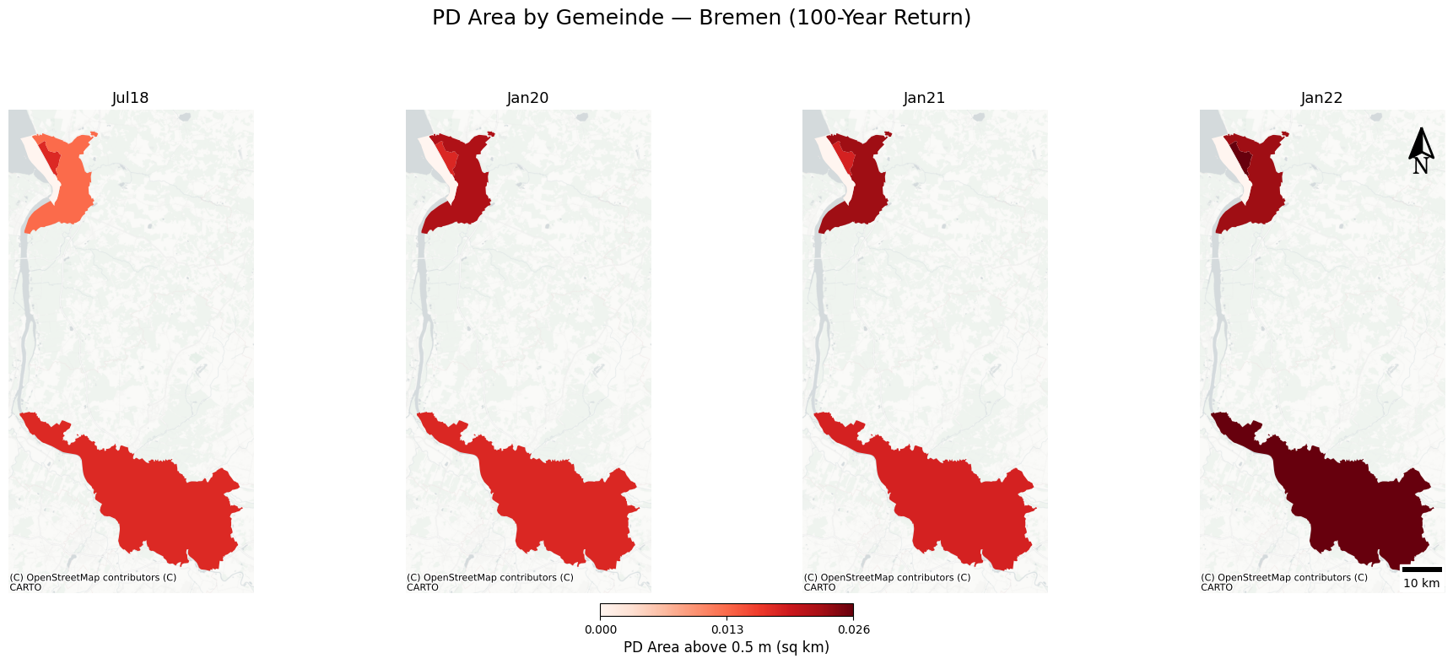
Bremen is not included for a similar reason; only a small area experienced a substantial percentage increase in flooding depth exceeding 0.5 meters.

Slide 7
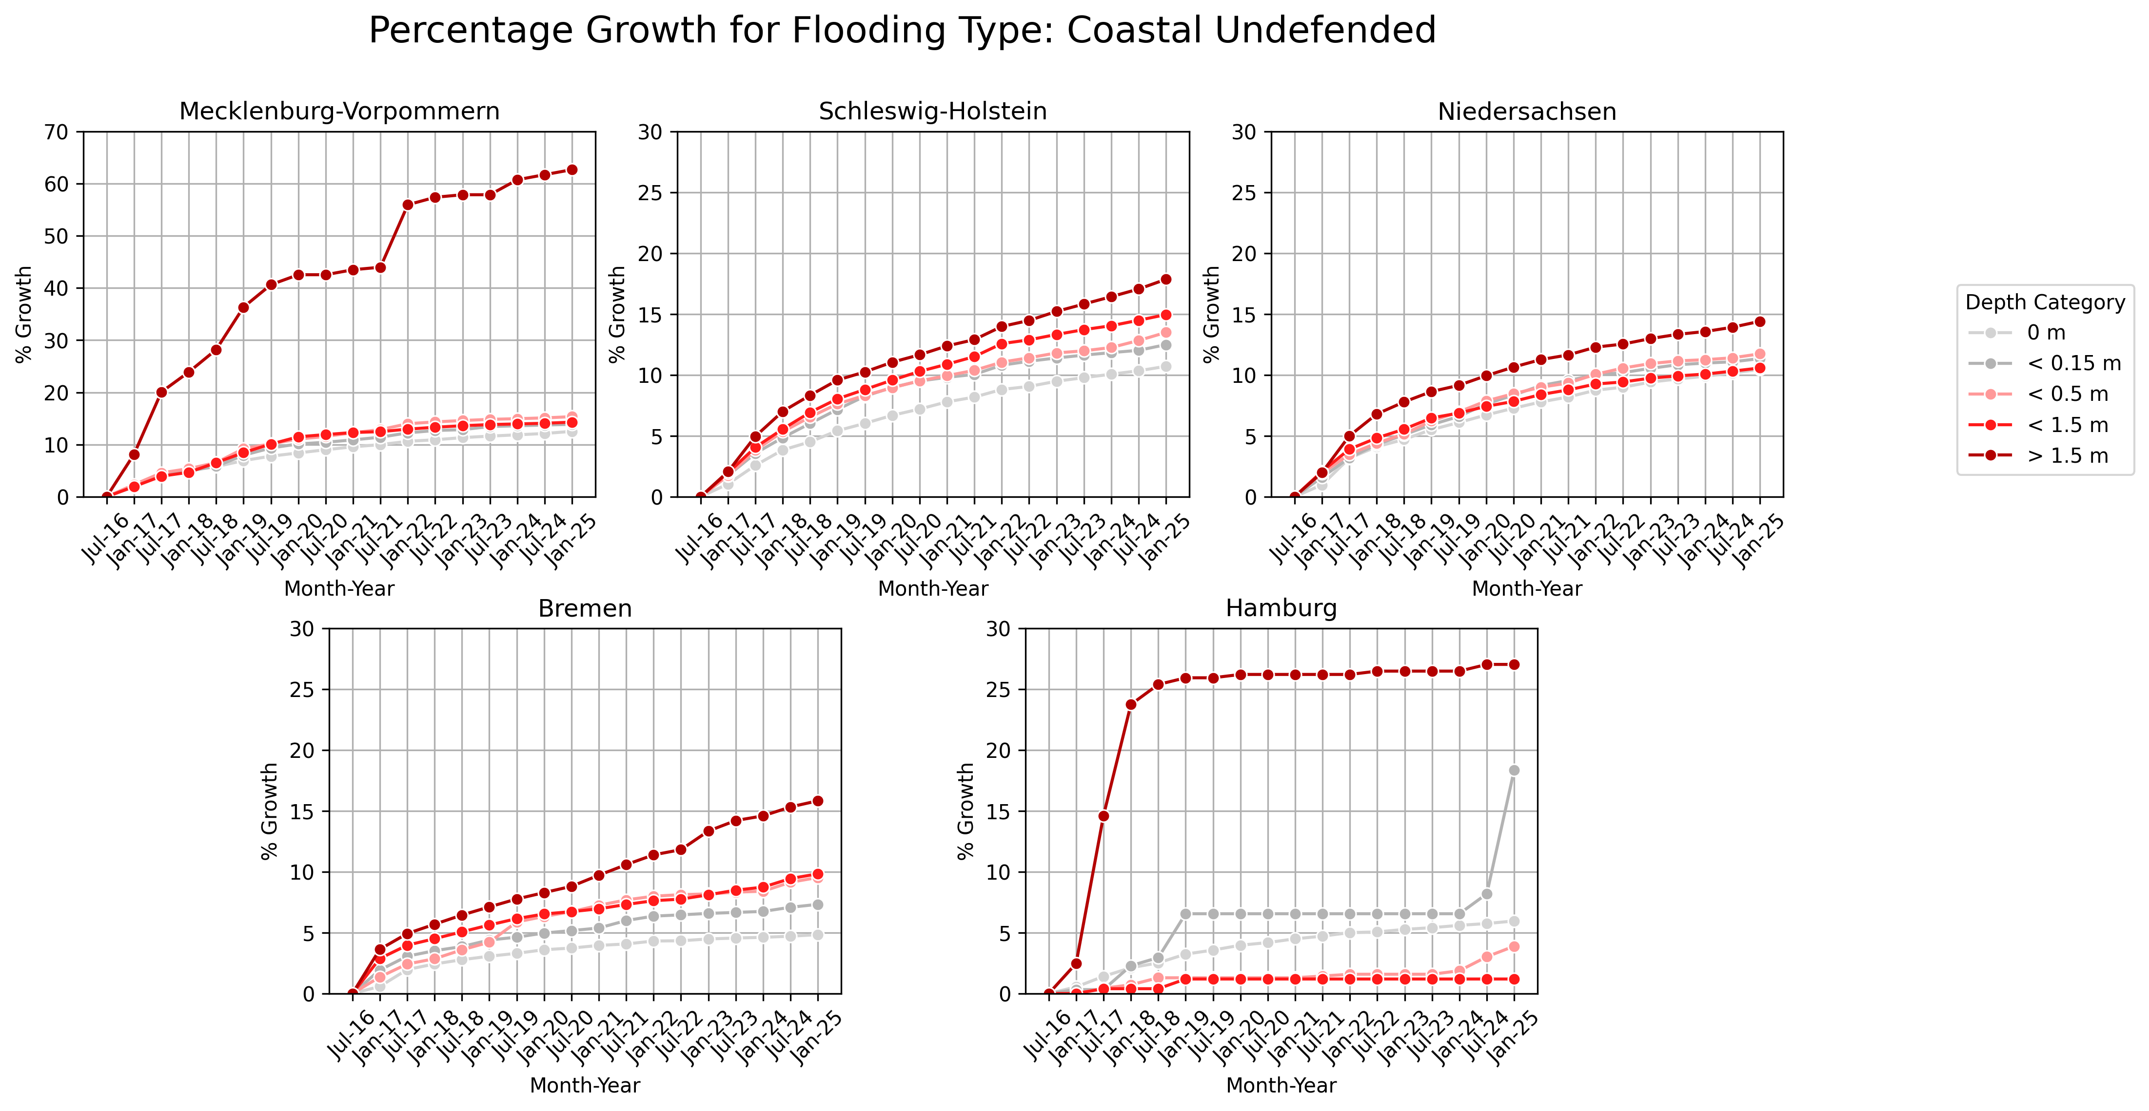

Slide 8
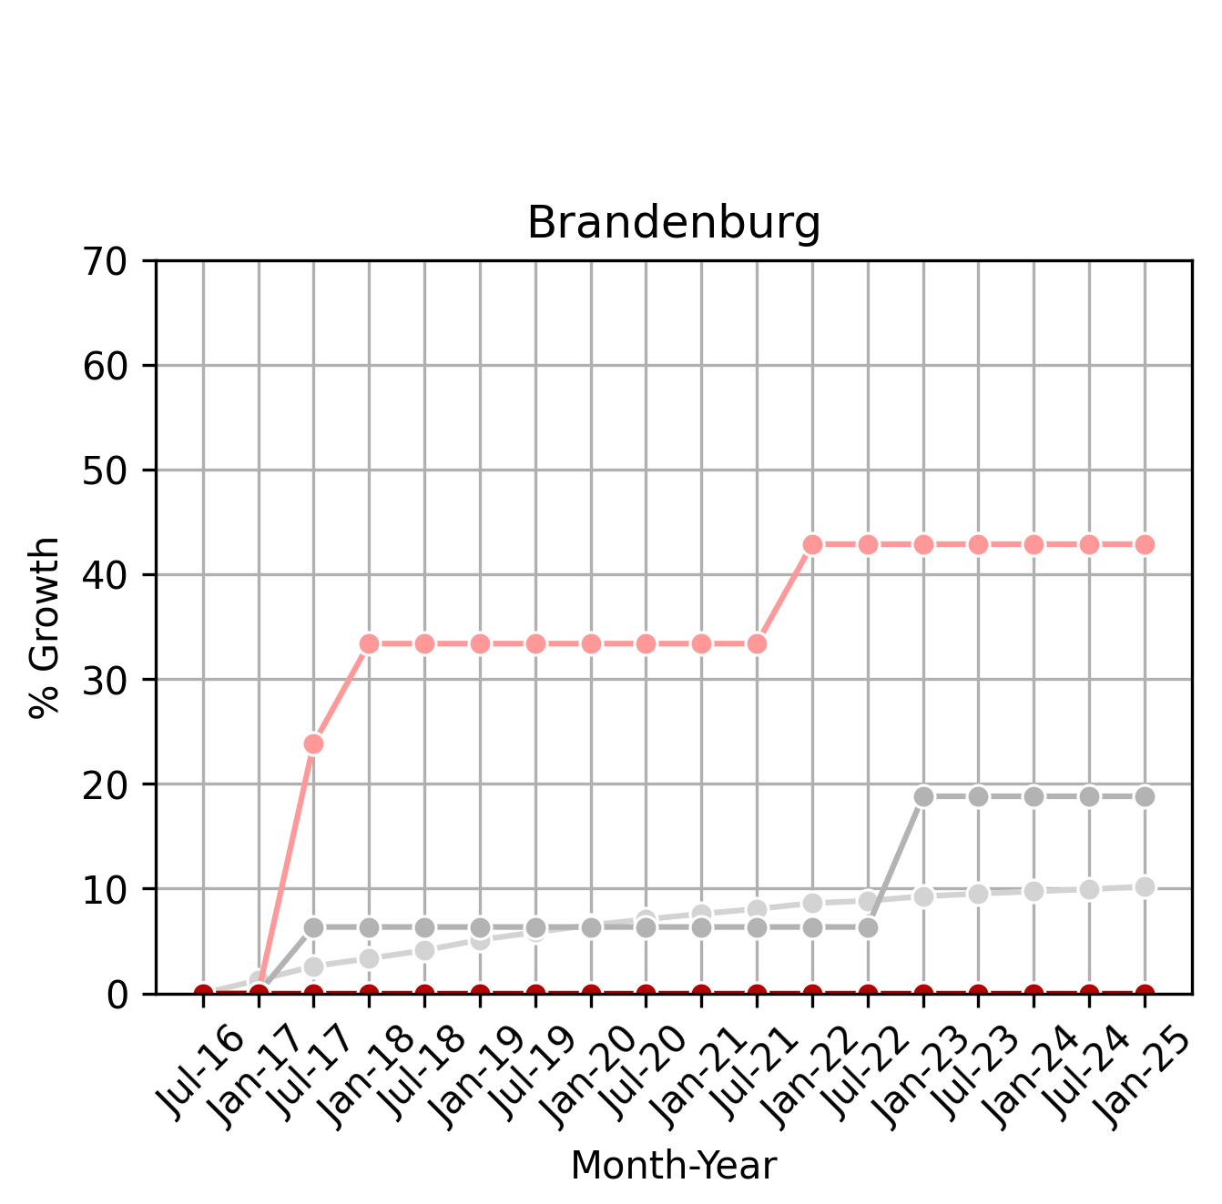
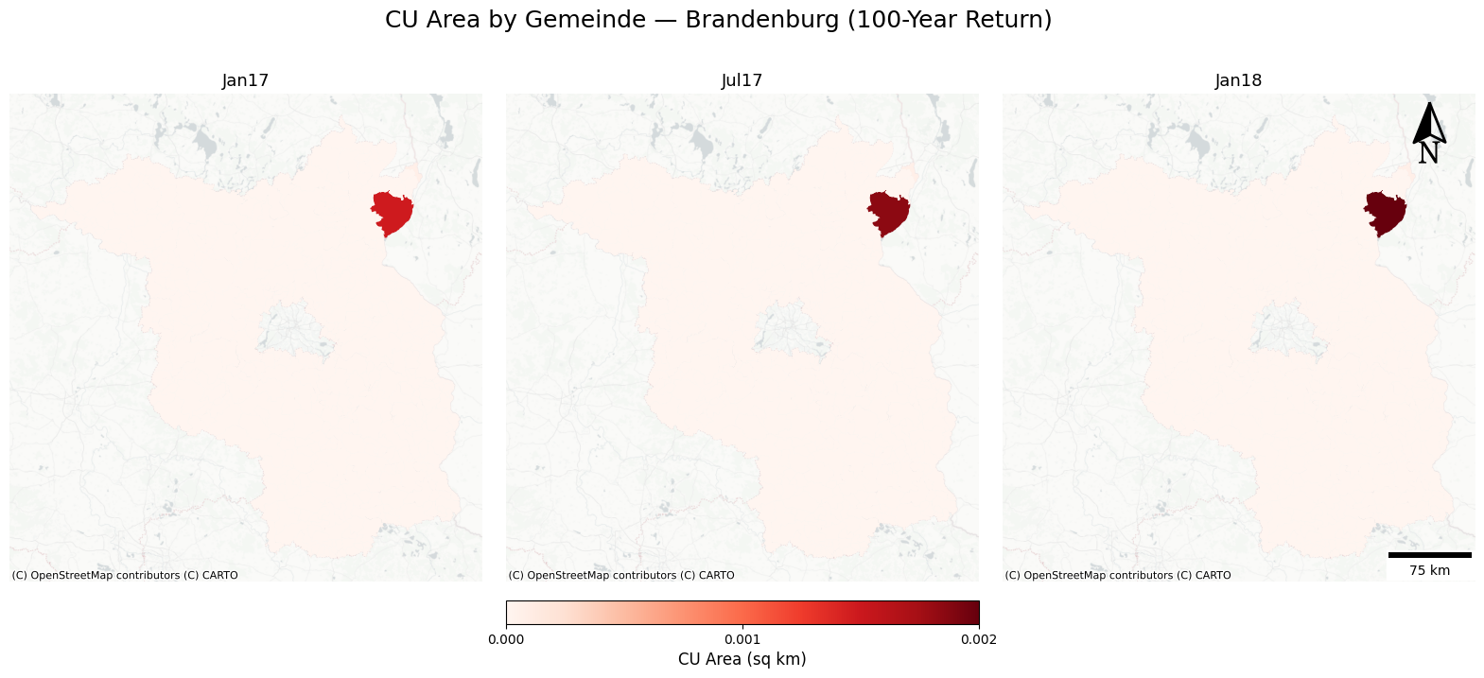
Same for Brandenburg under the coastal flooding scenario.
(flooding depth between 0.15 m and 0.5 m)

Slide 9
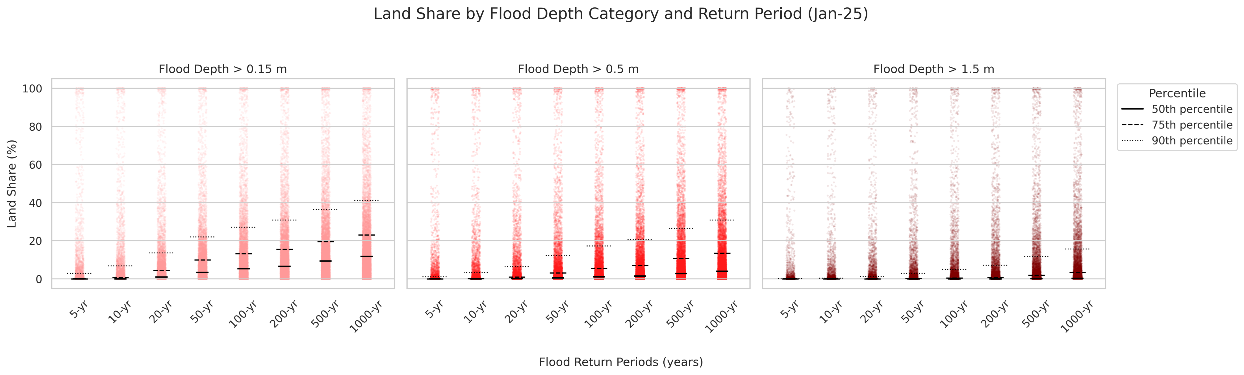

Slide 10
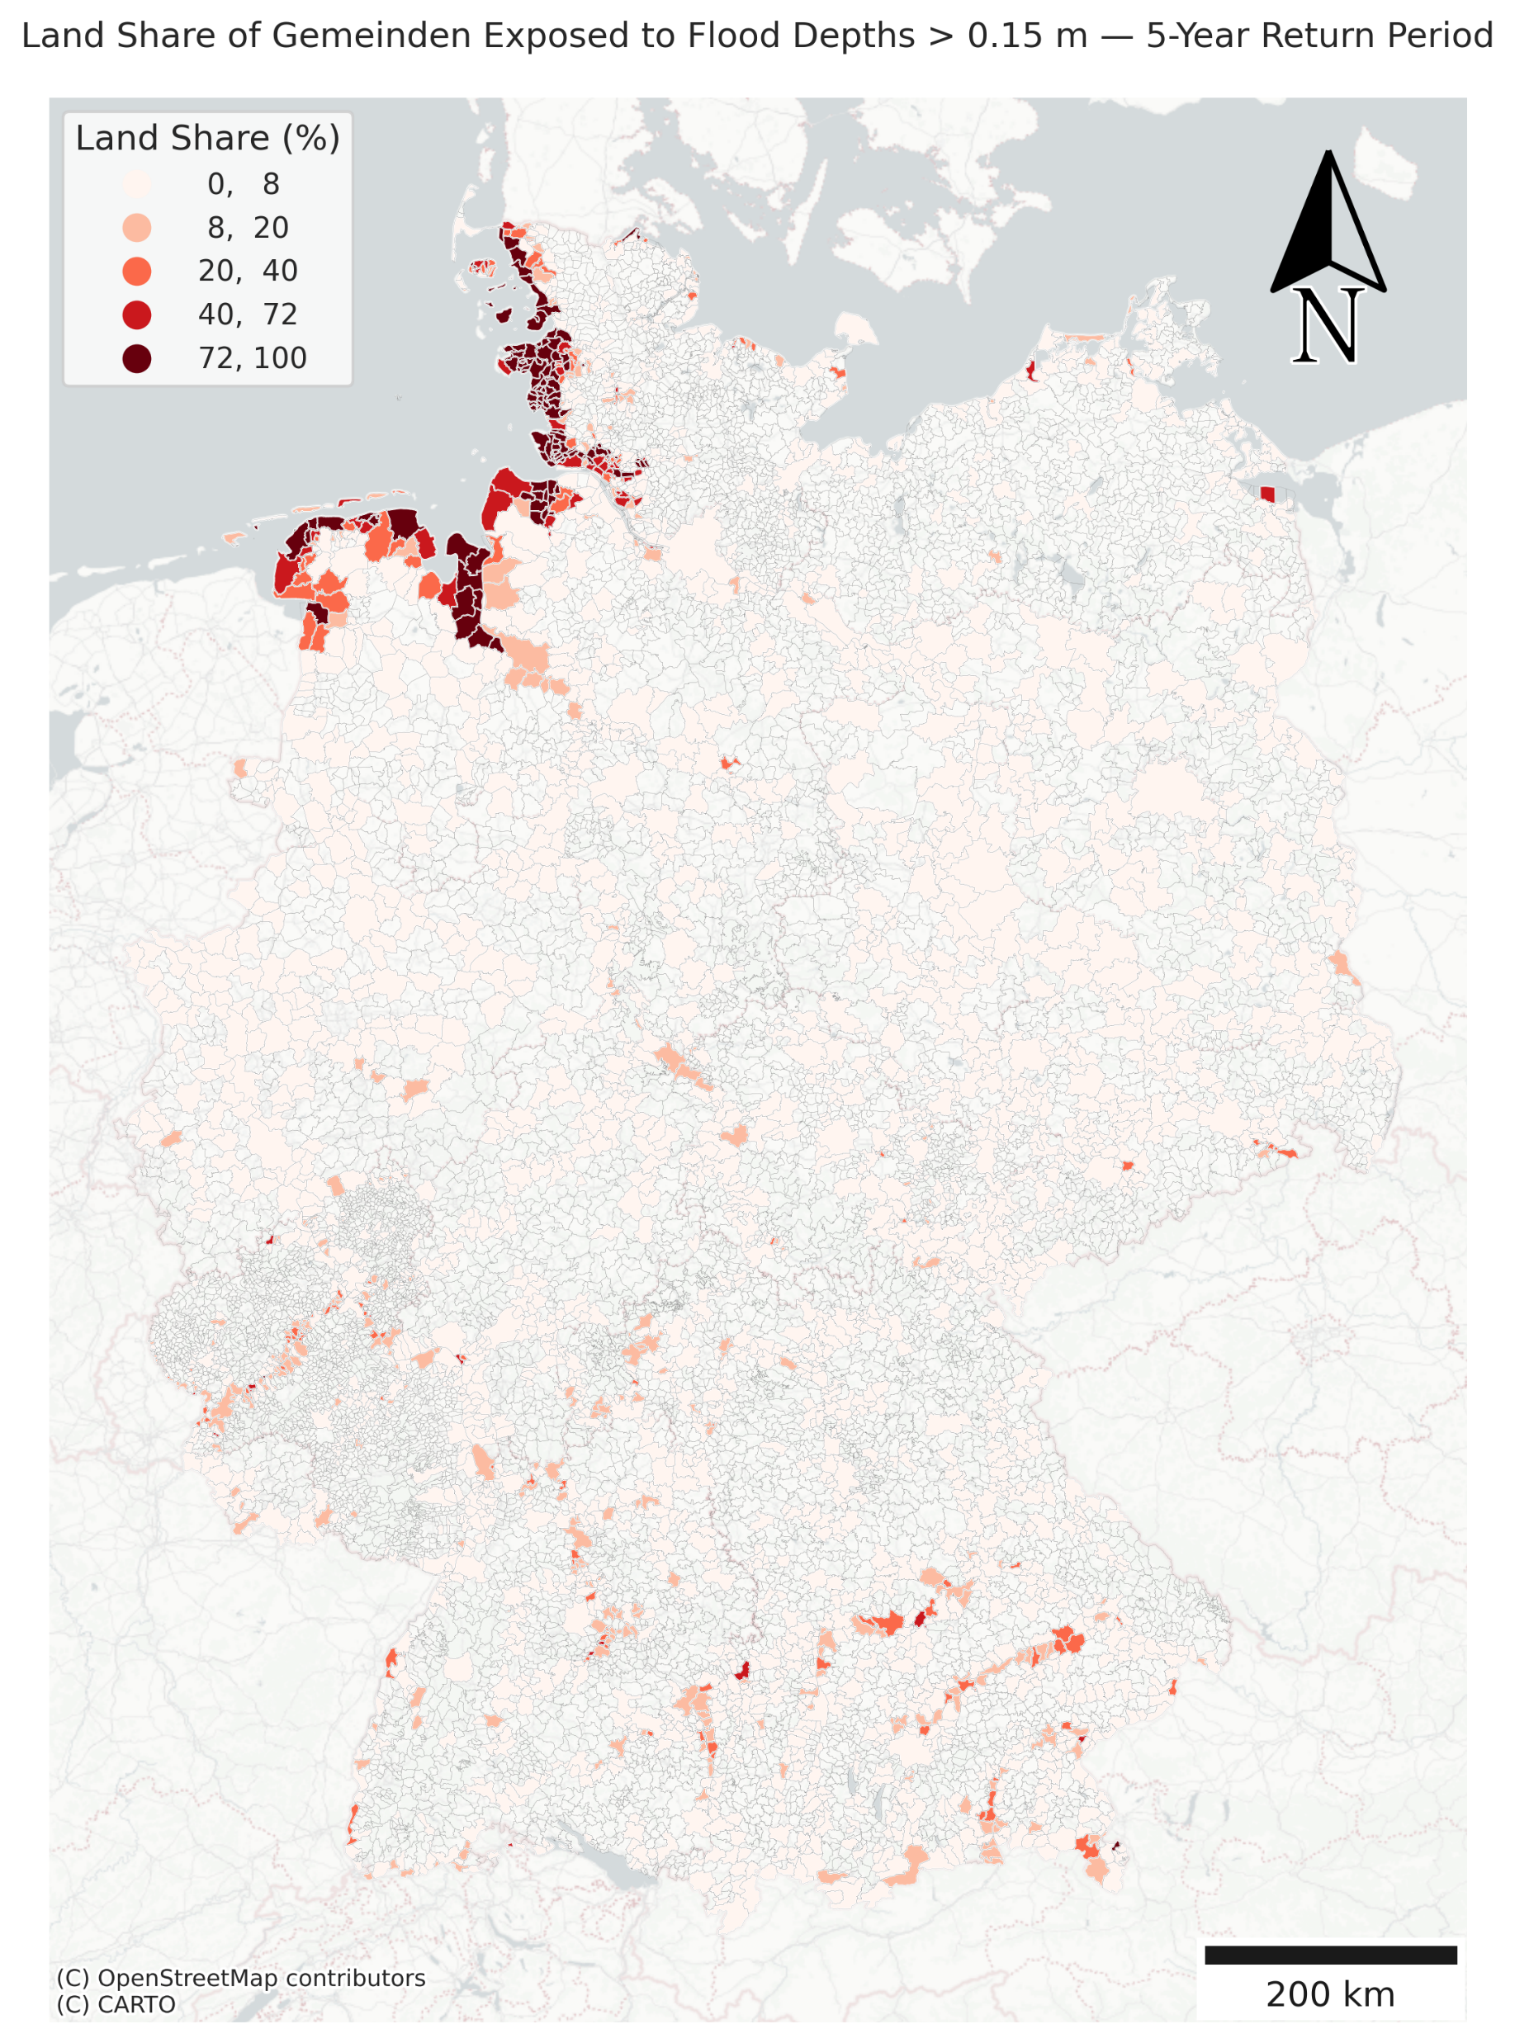
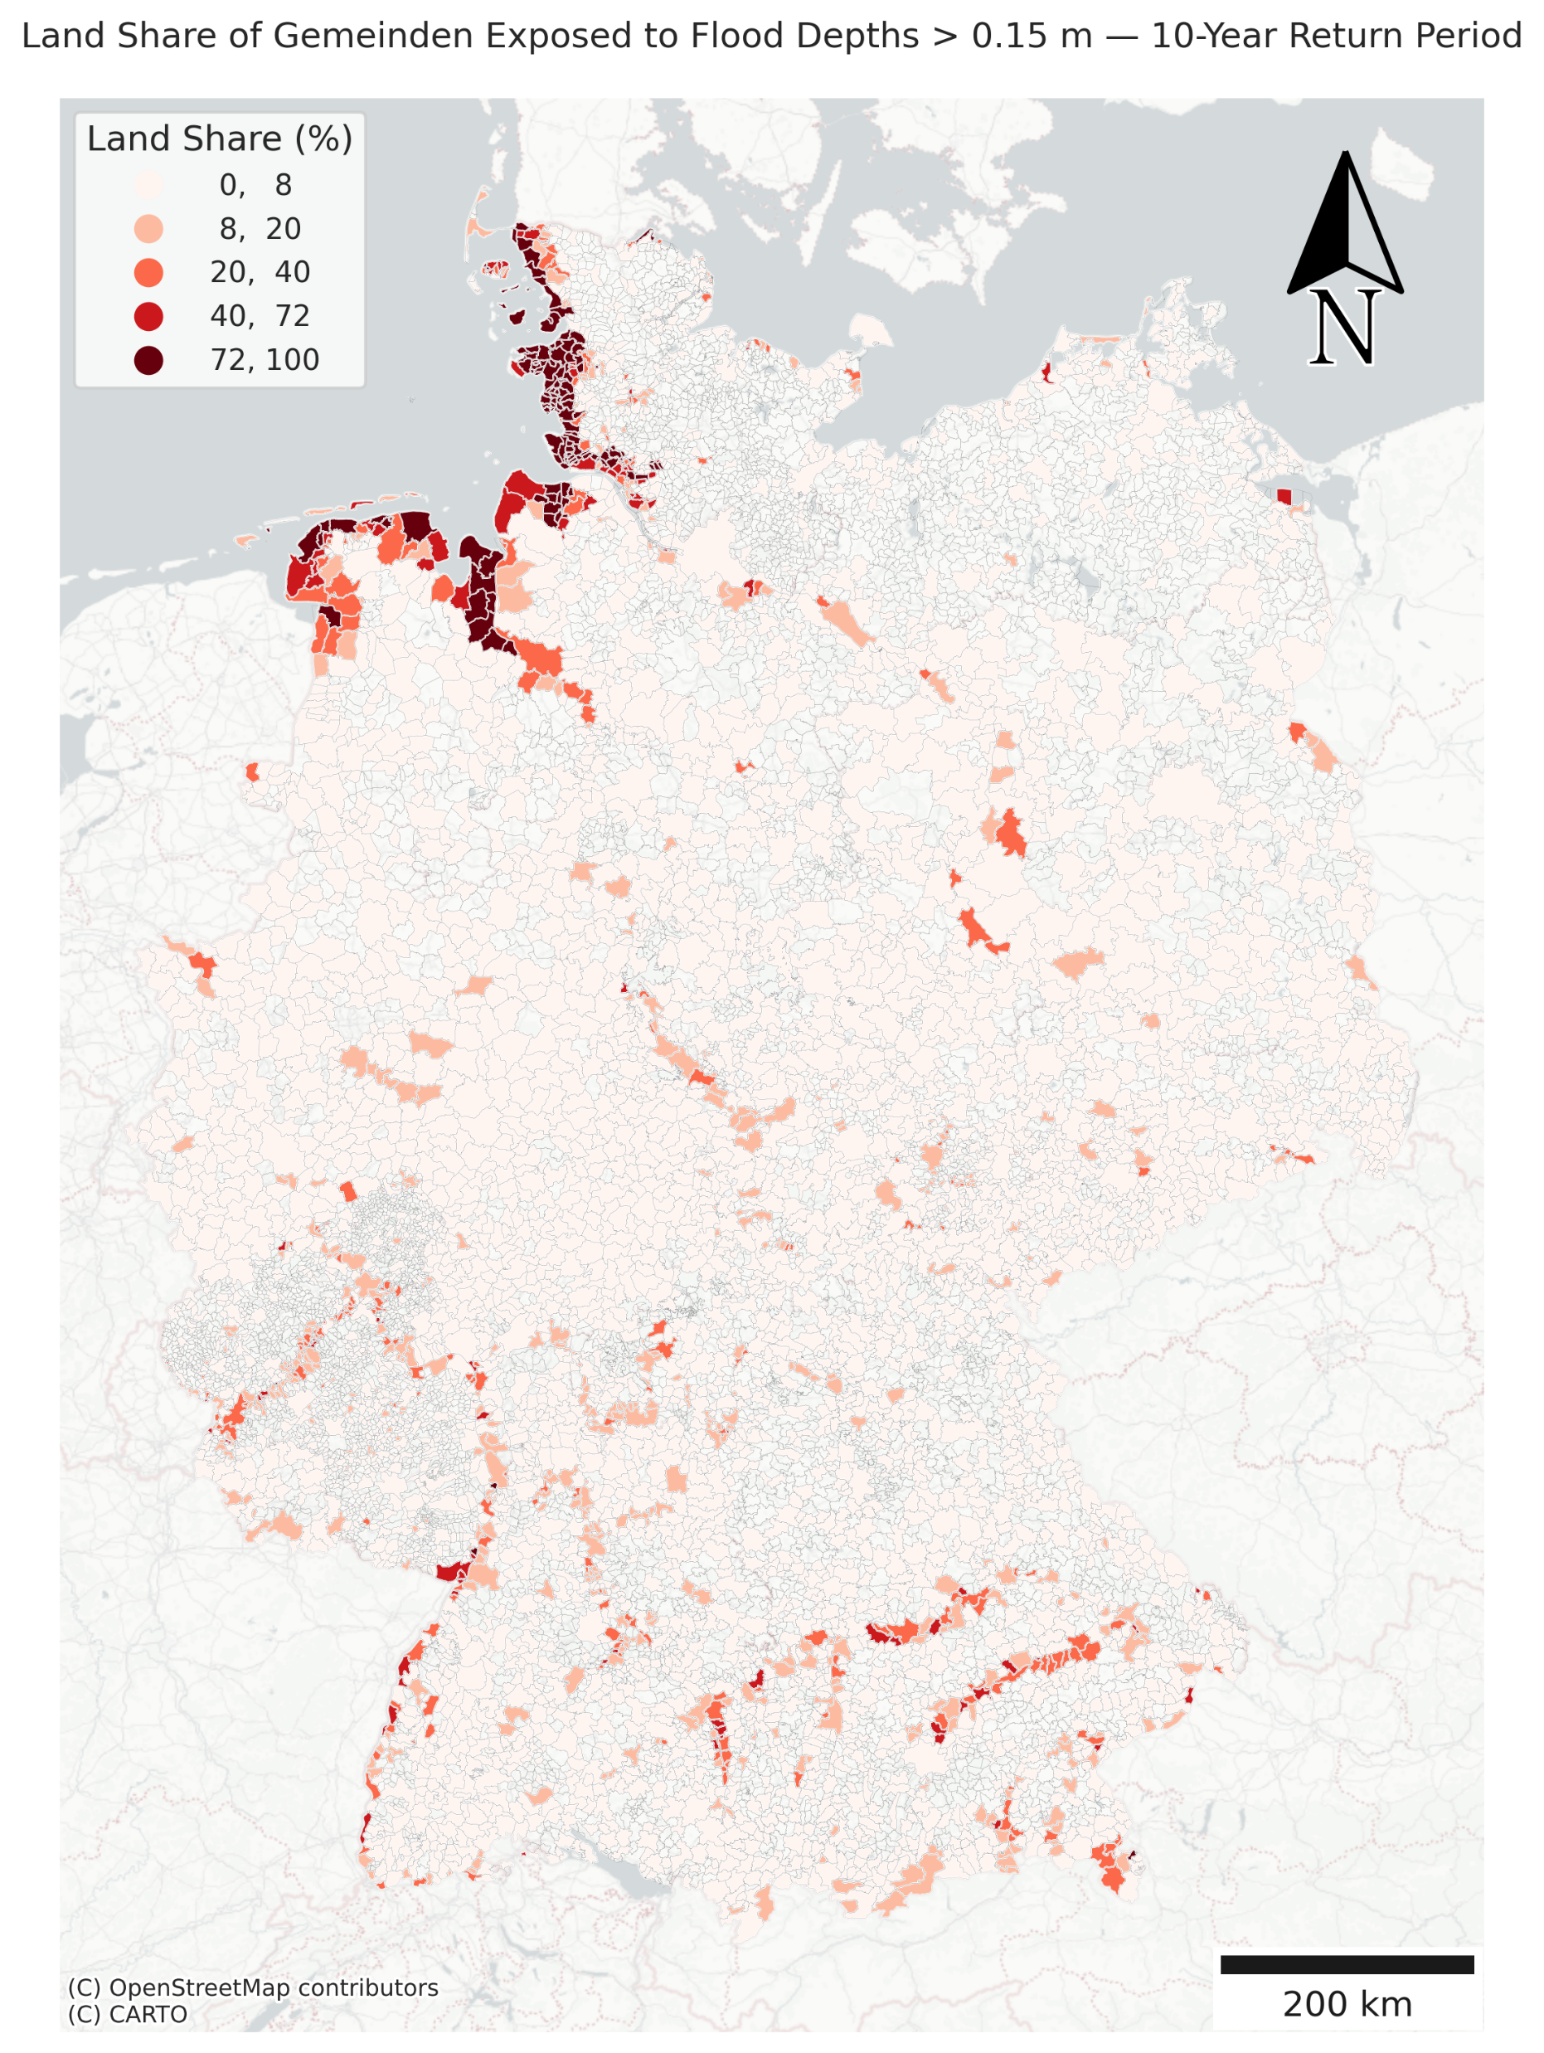
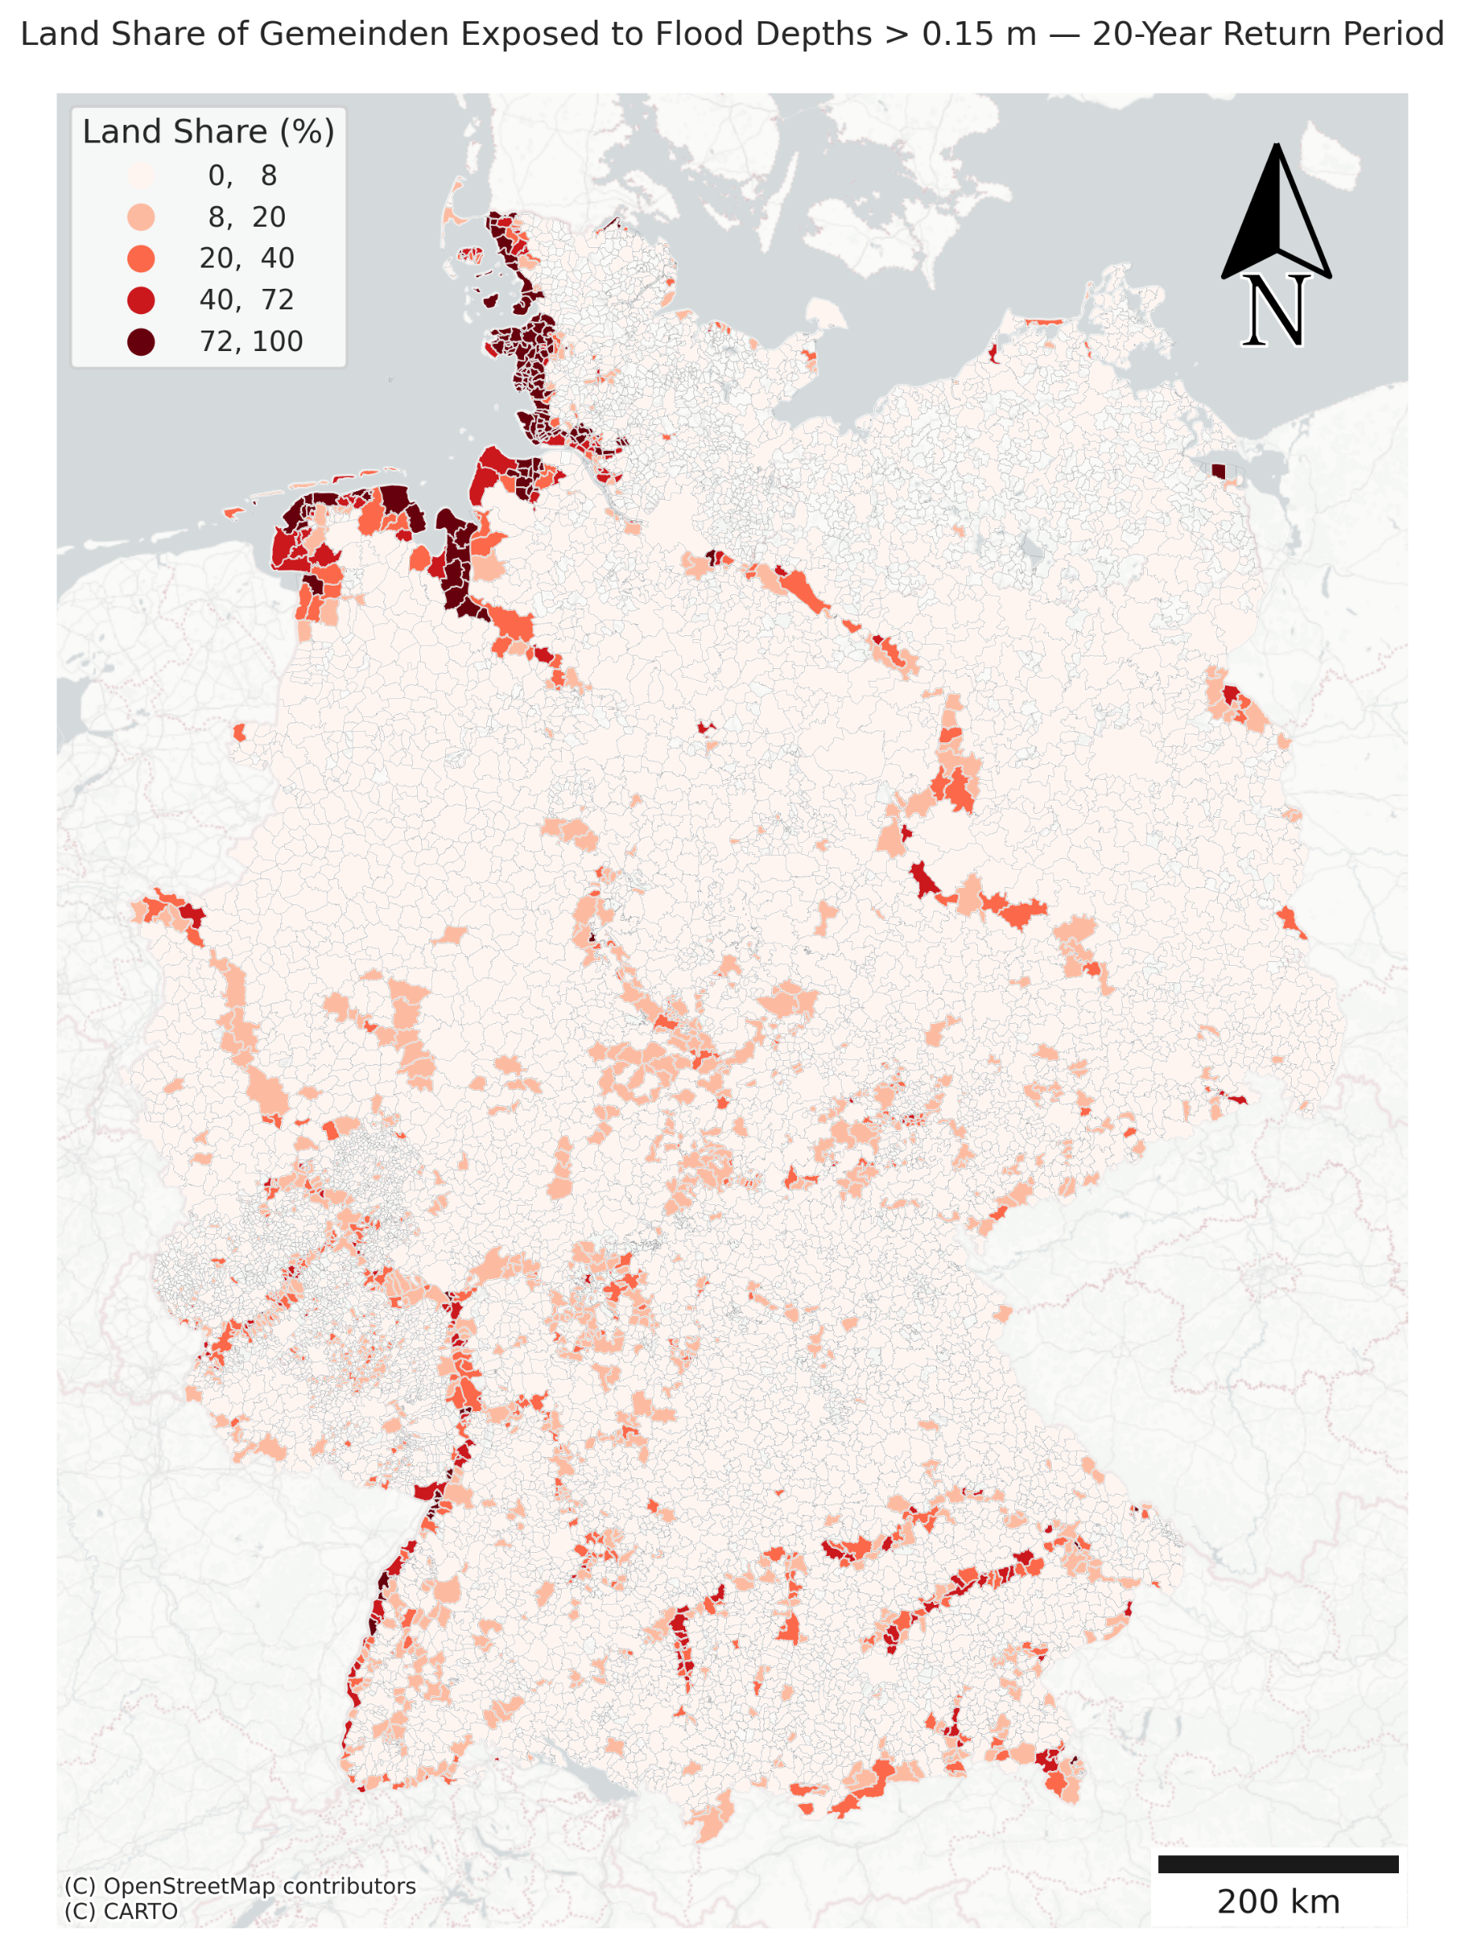
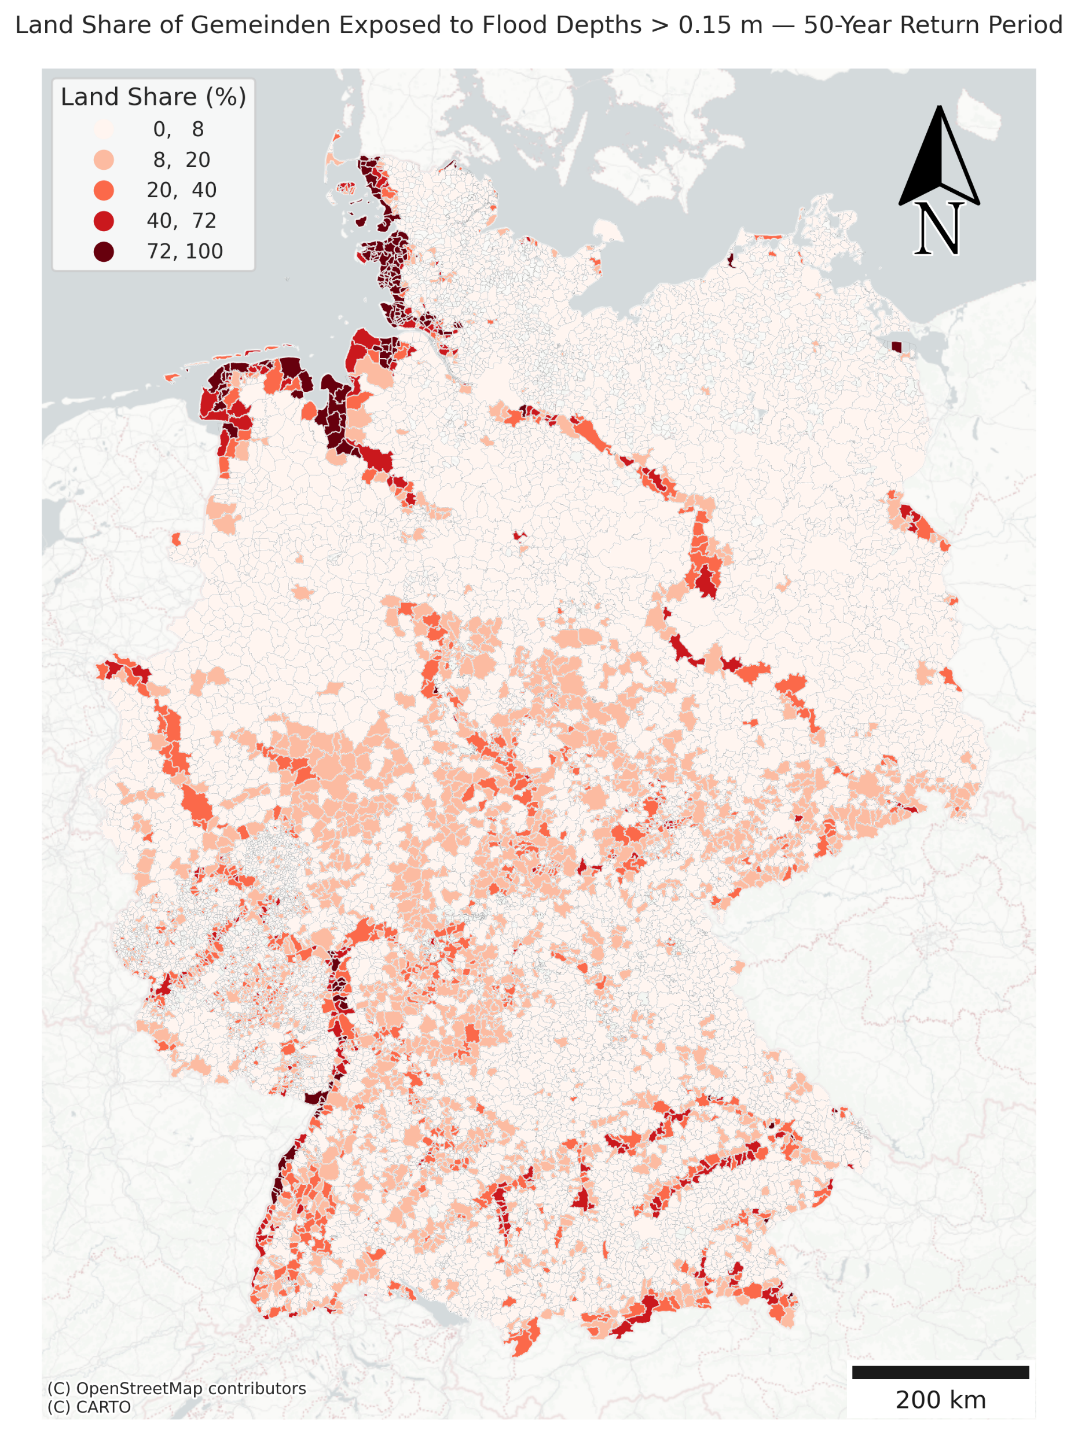

Slide 11
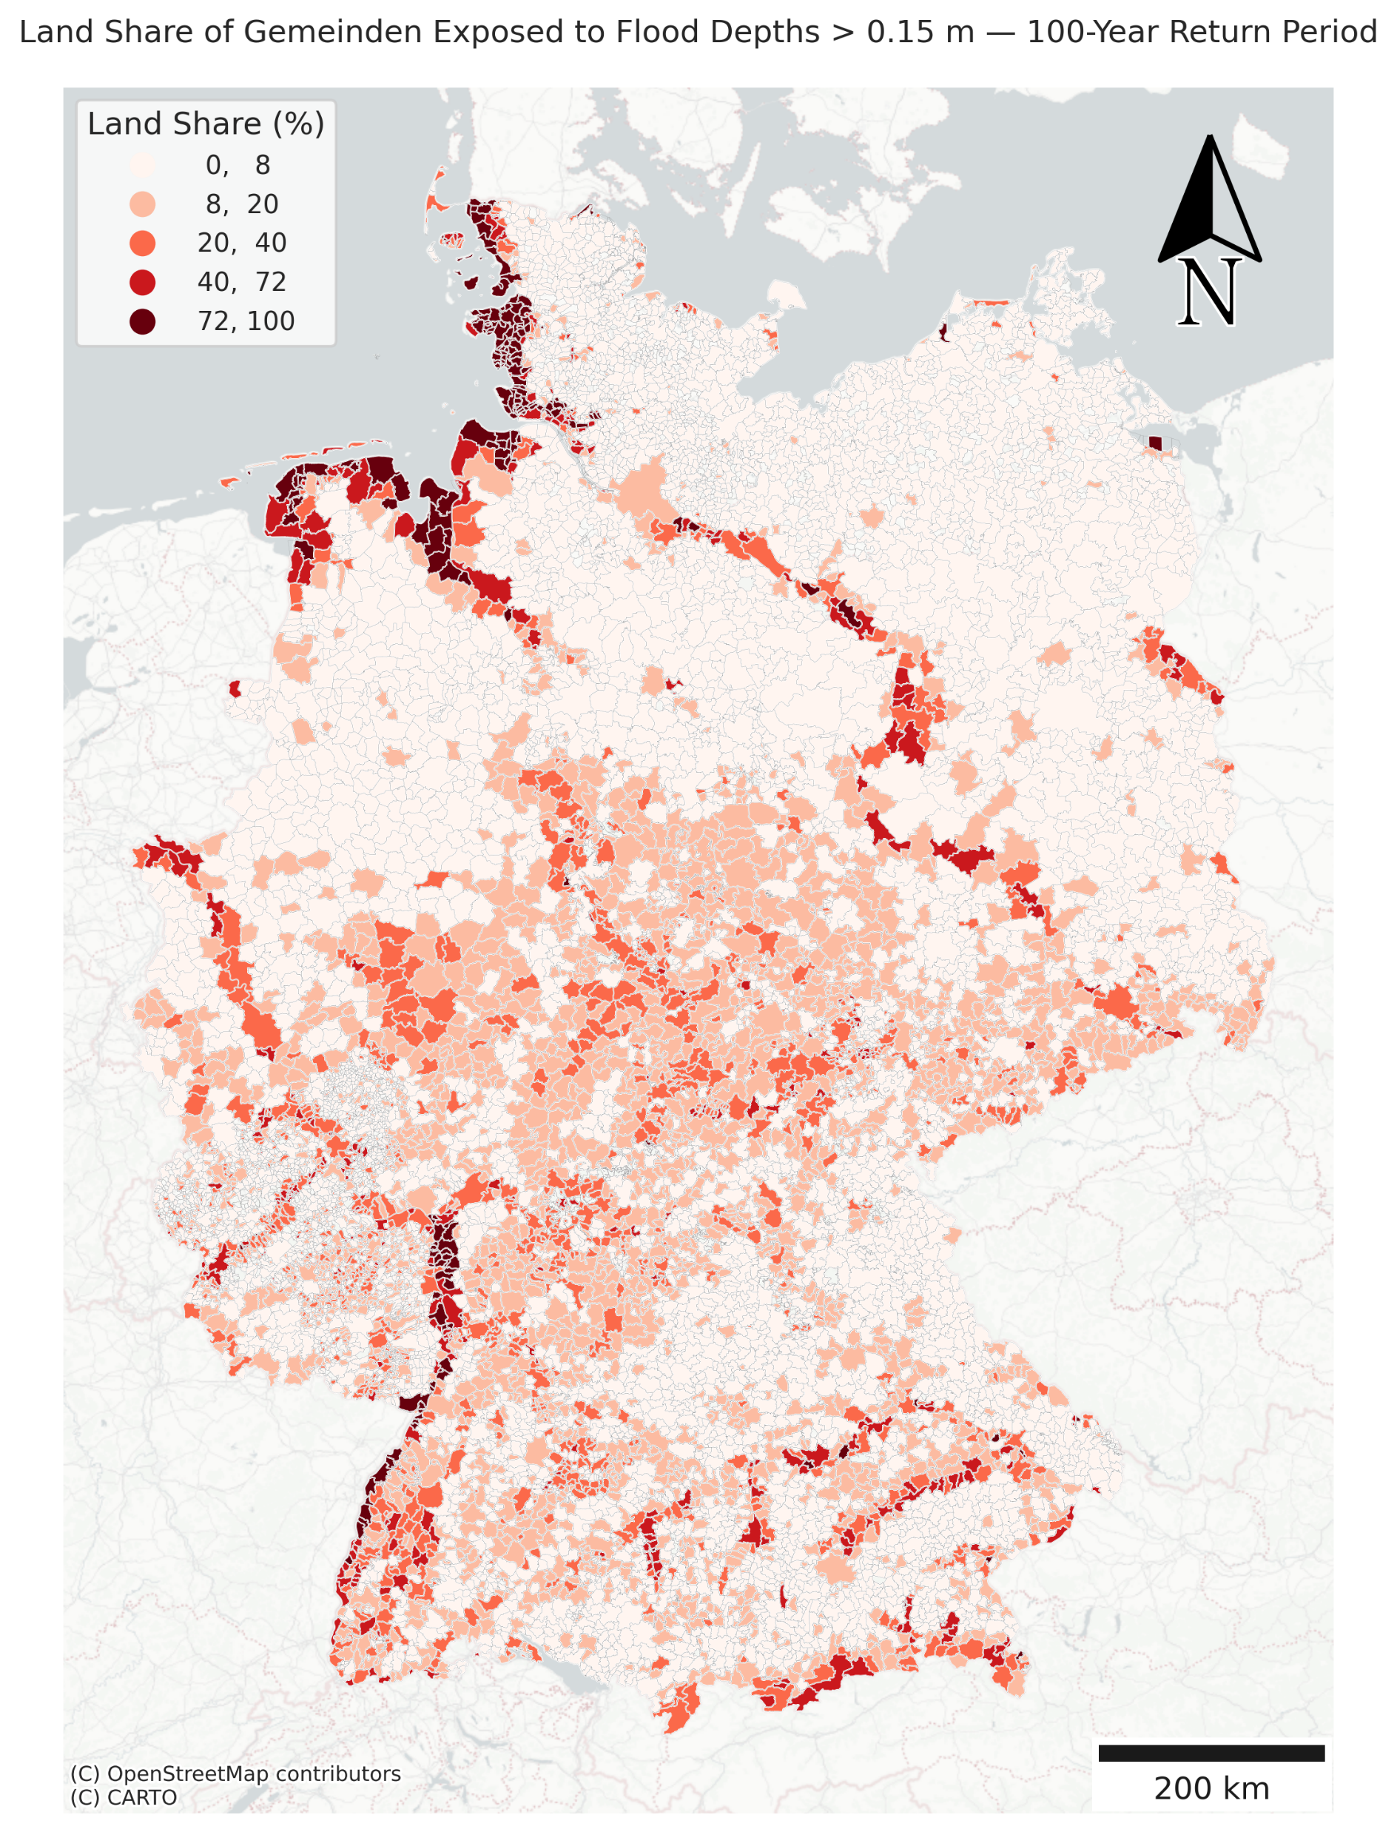
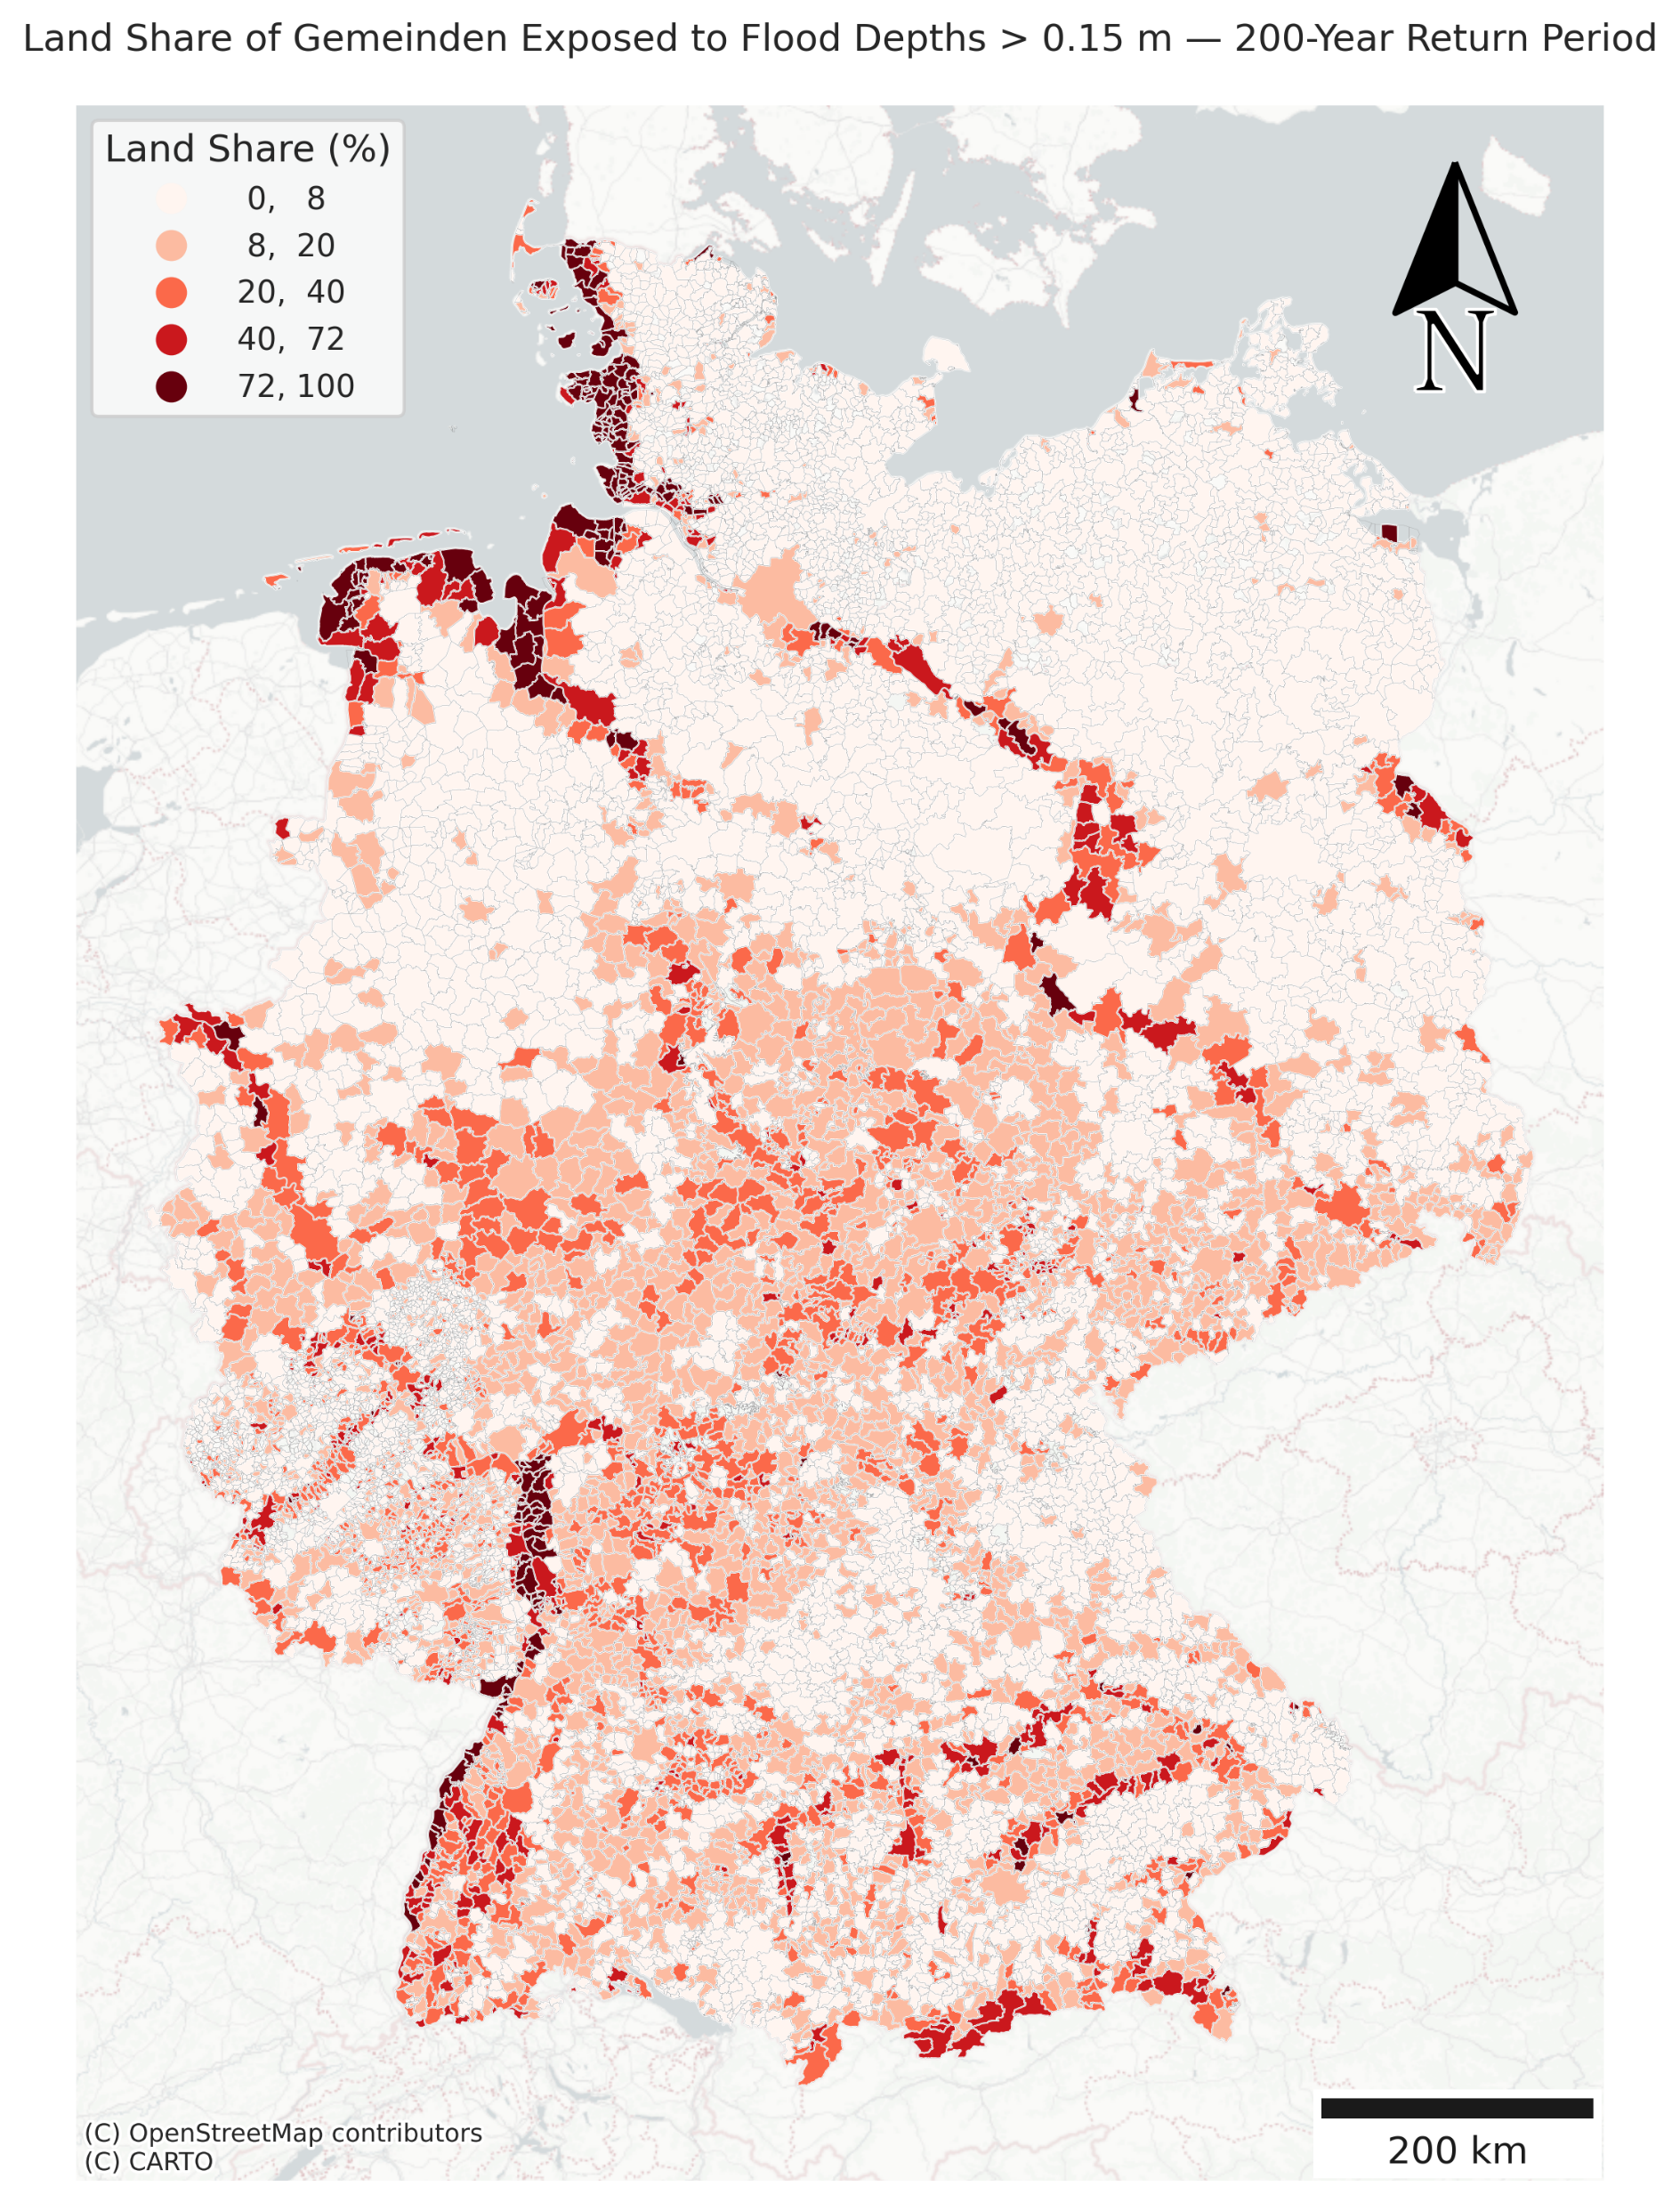
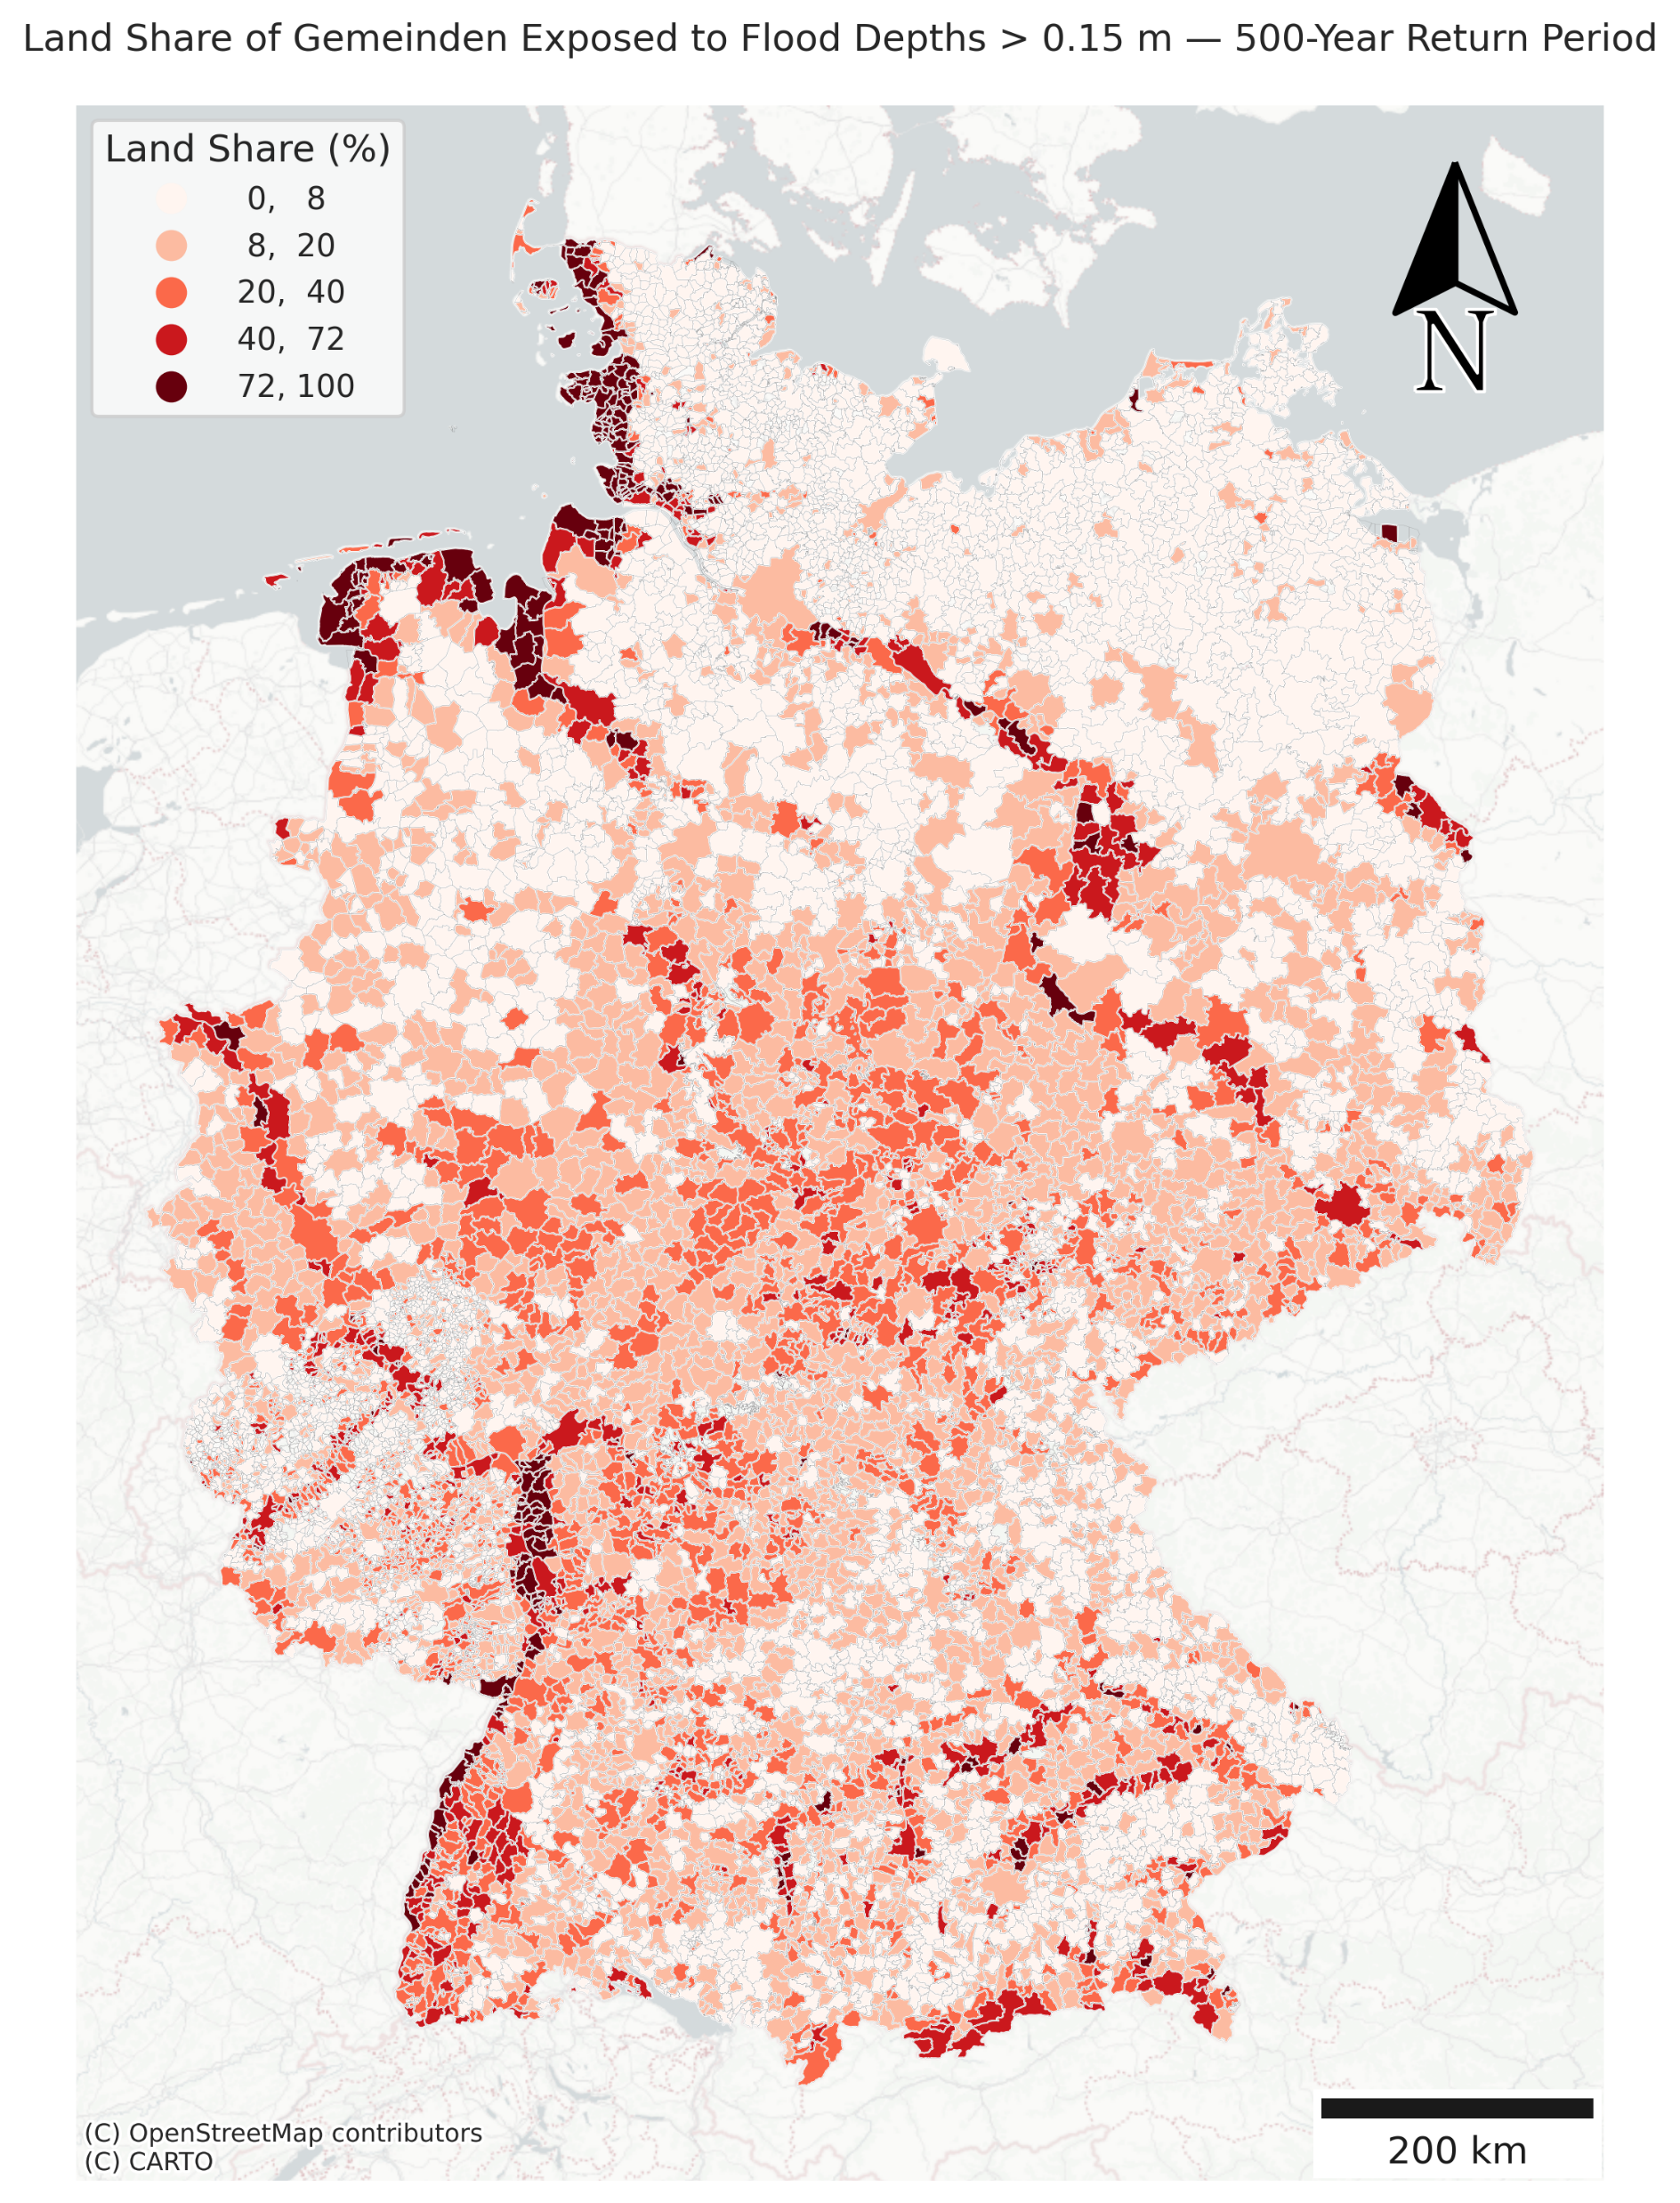
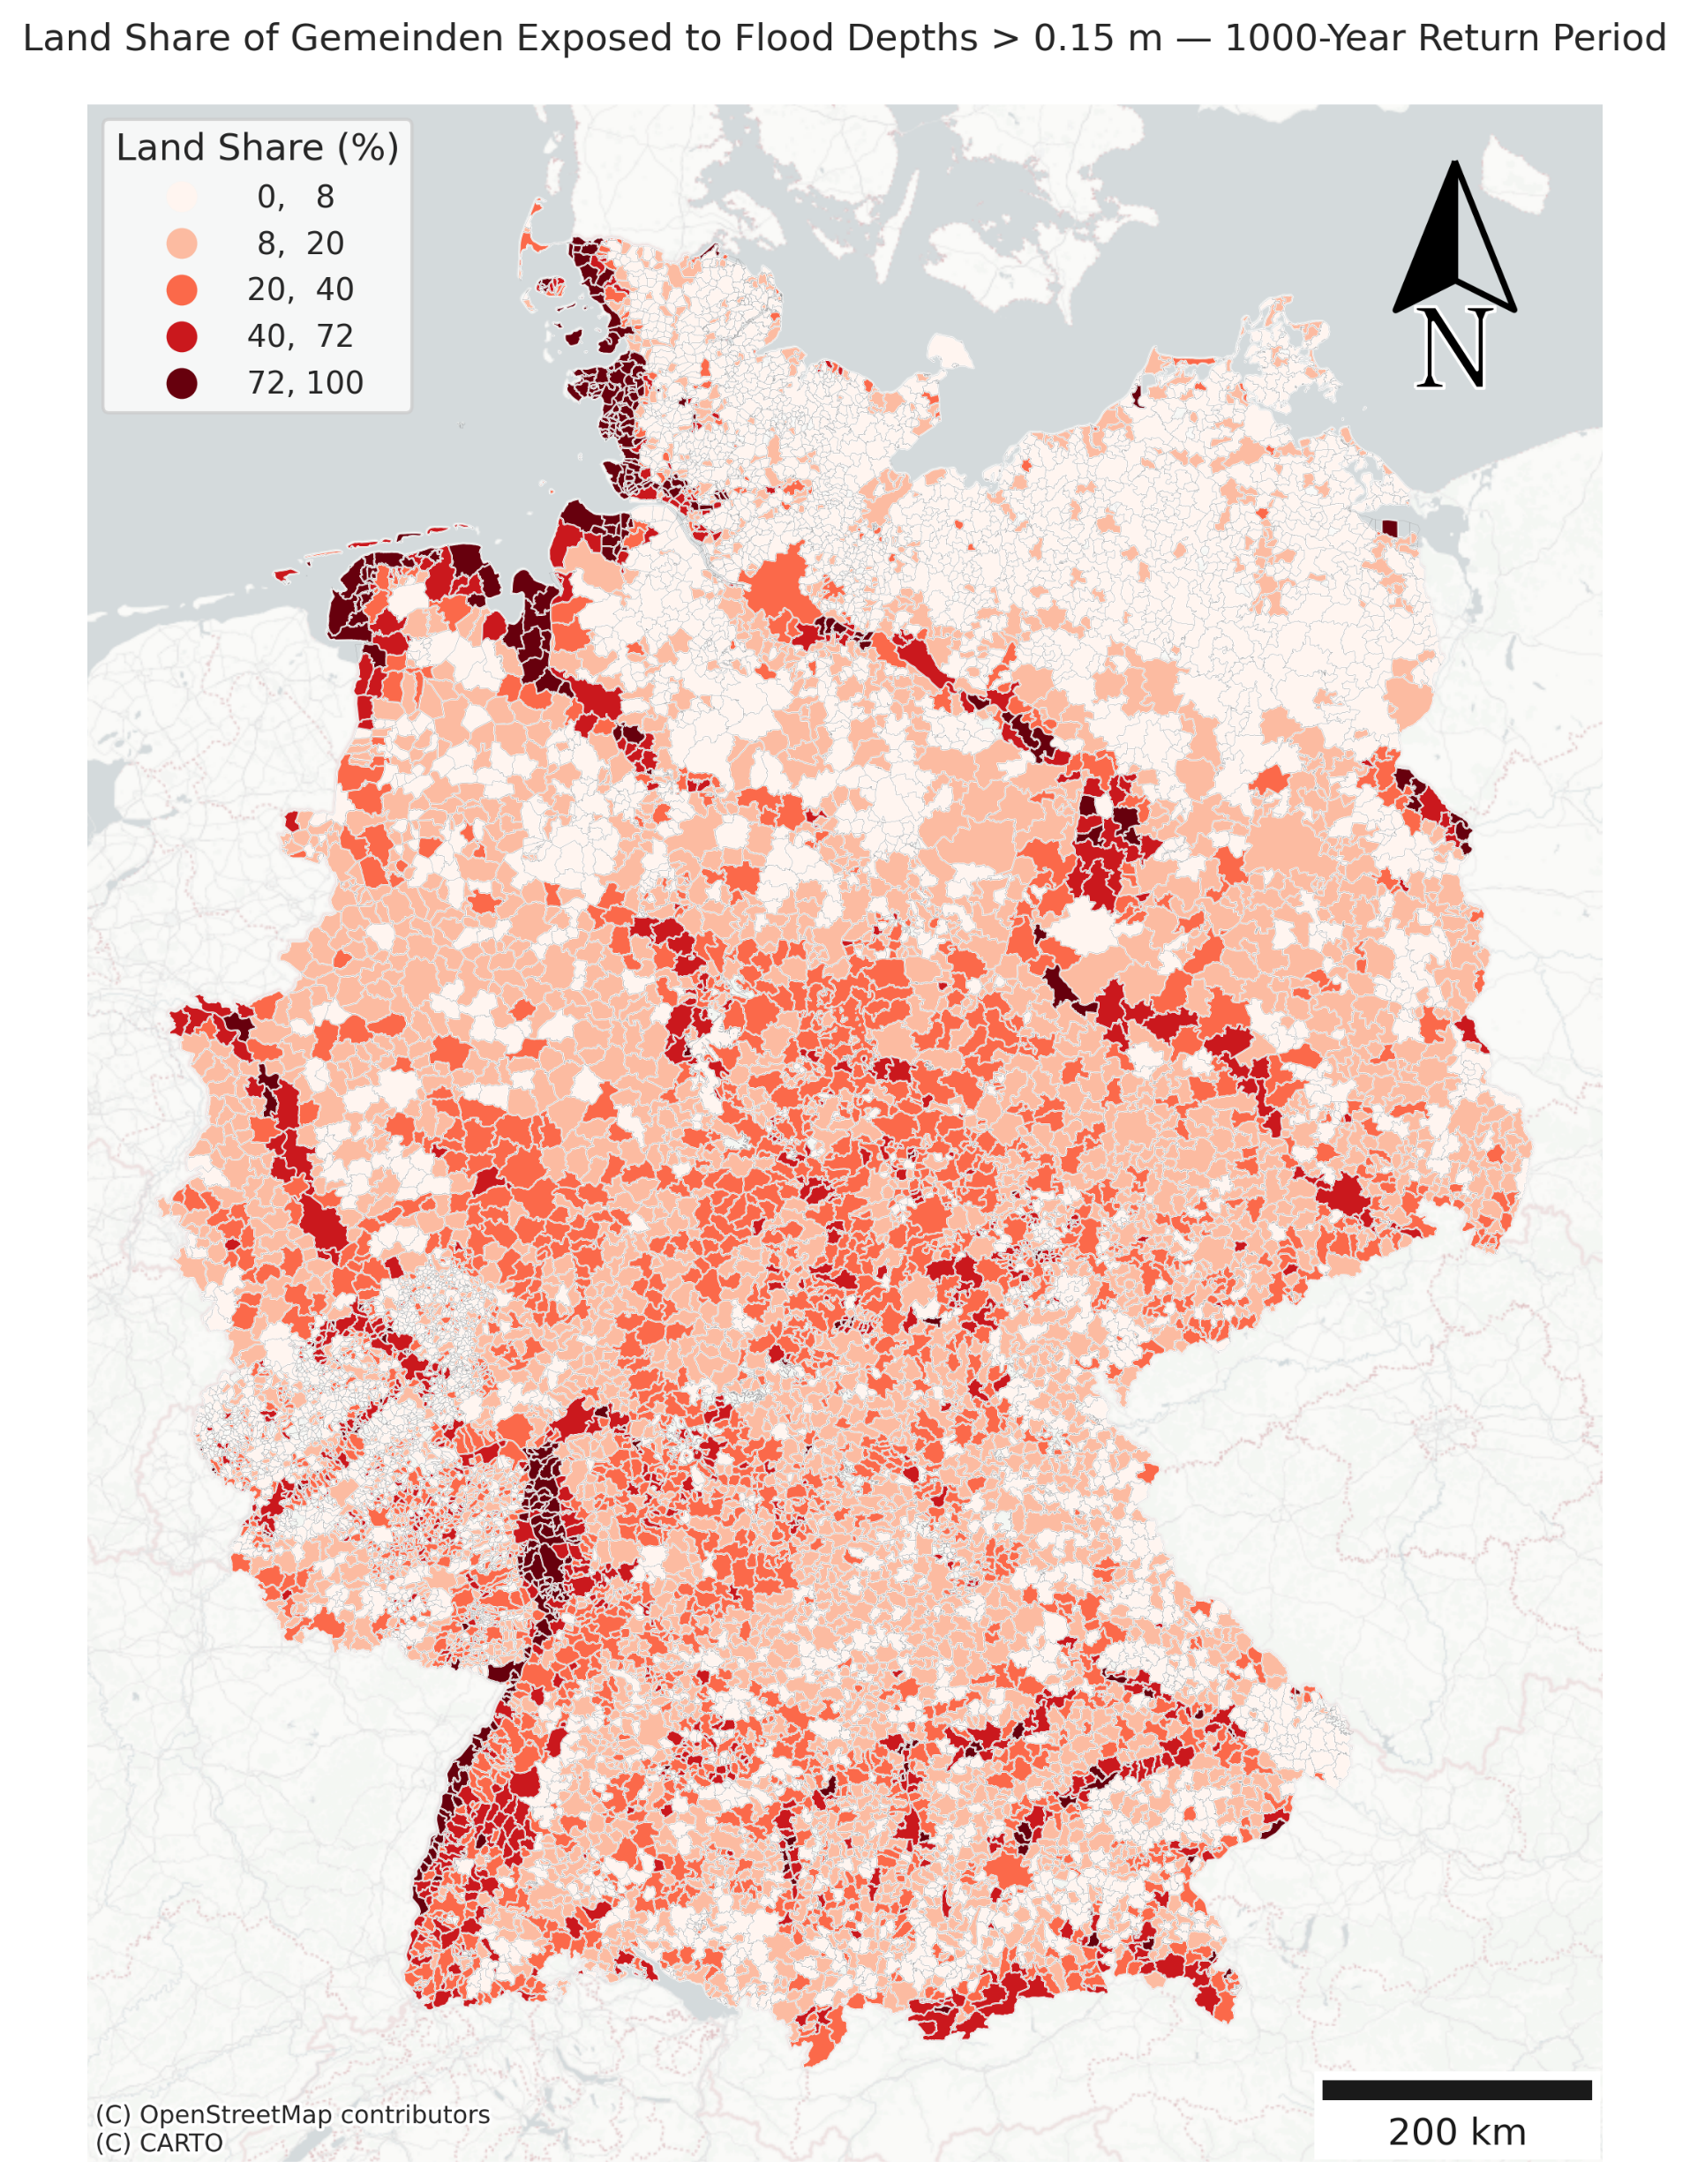

Slide 12
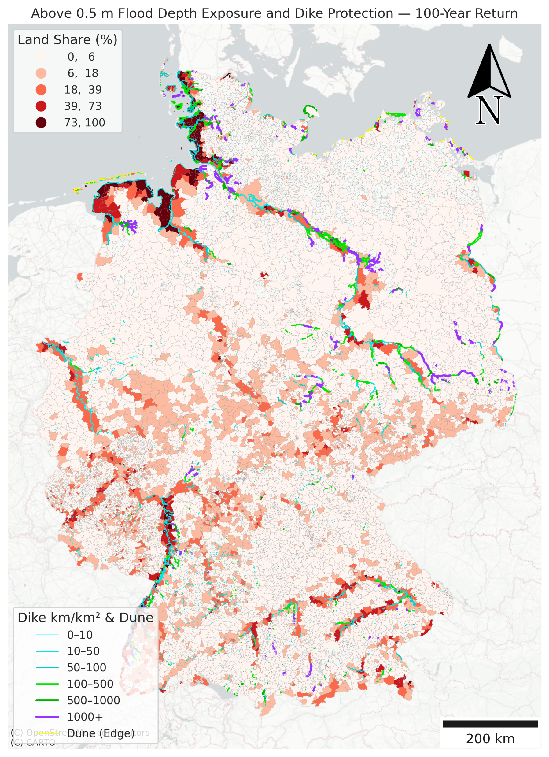
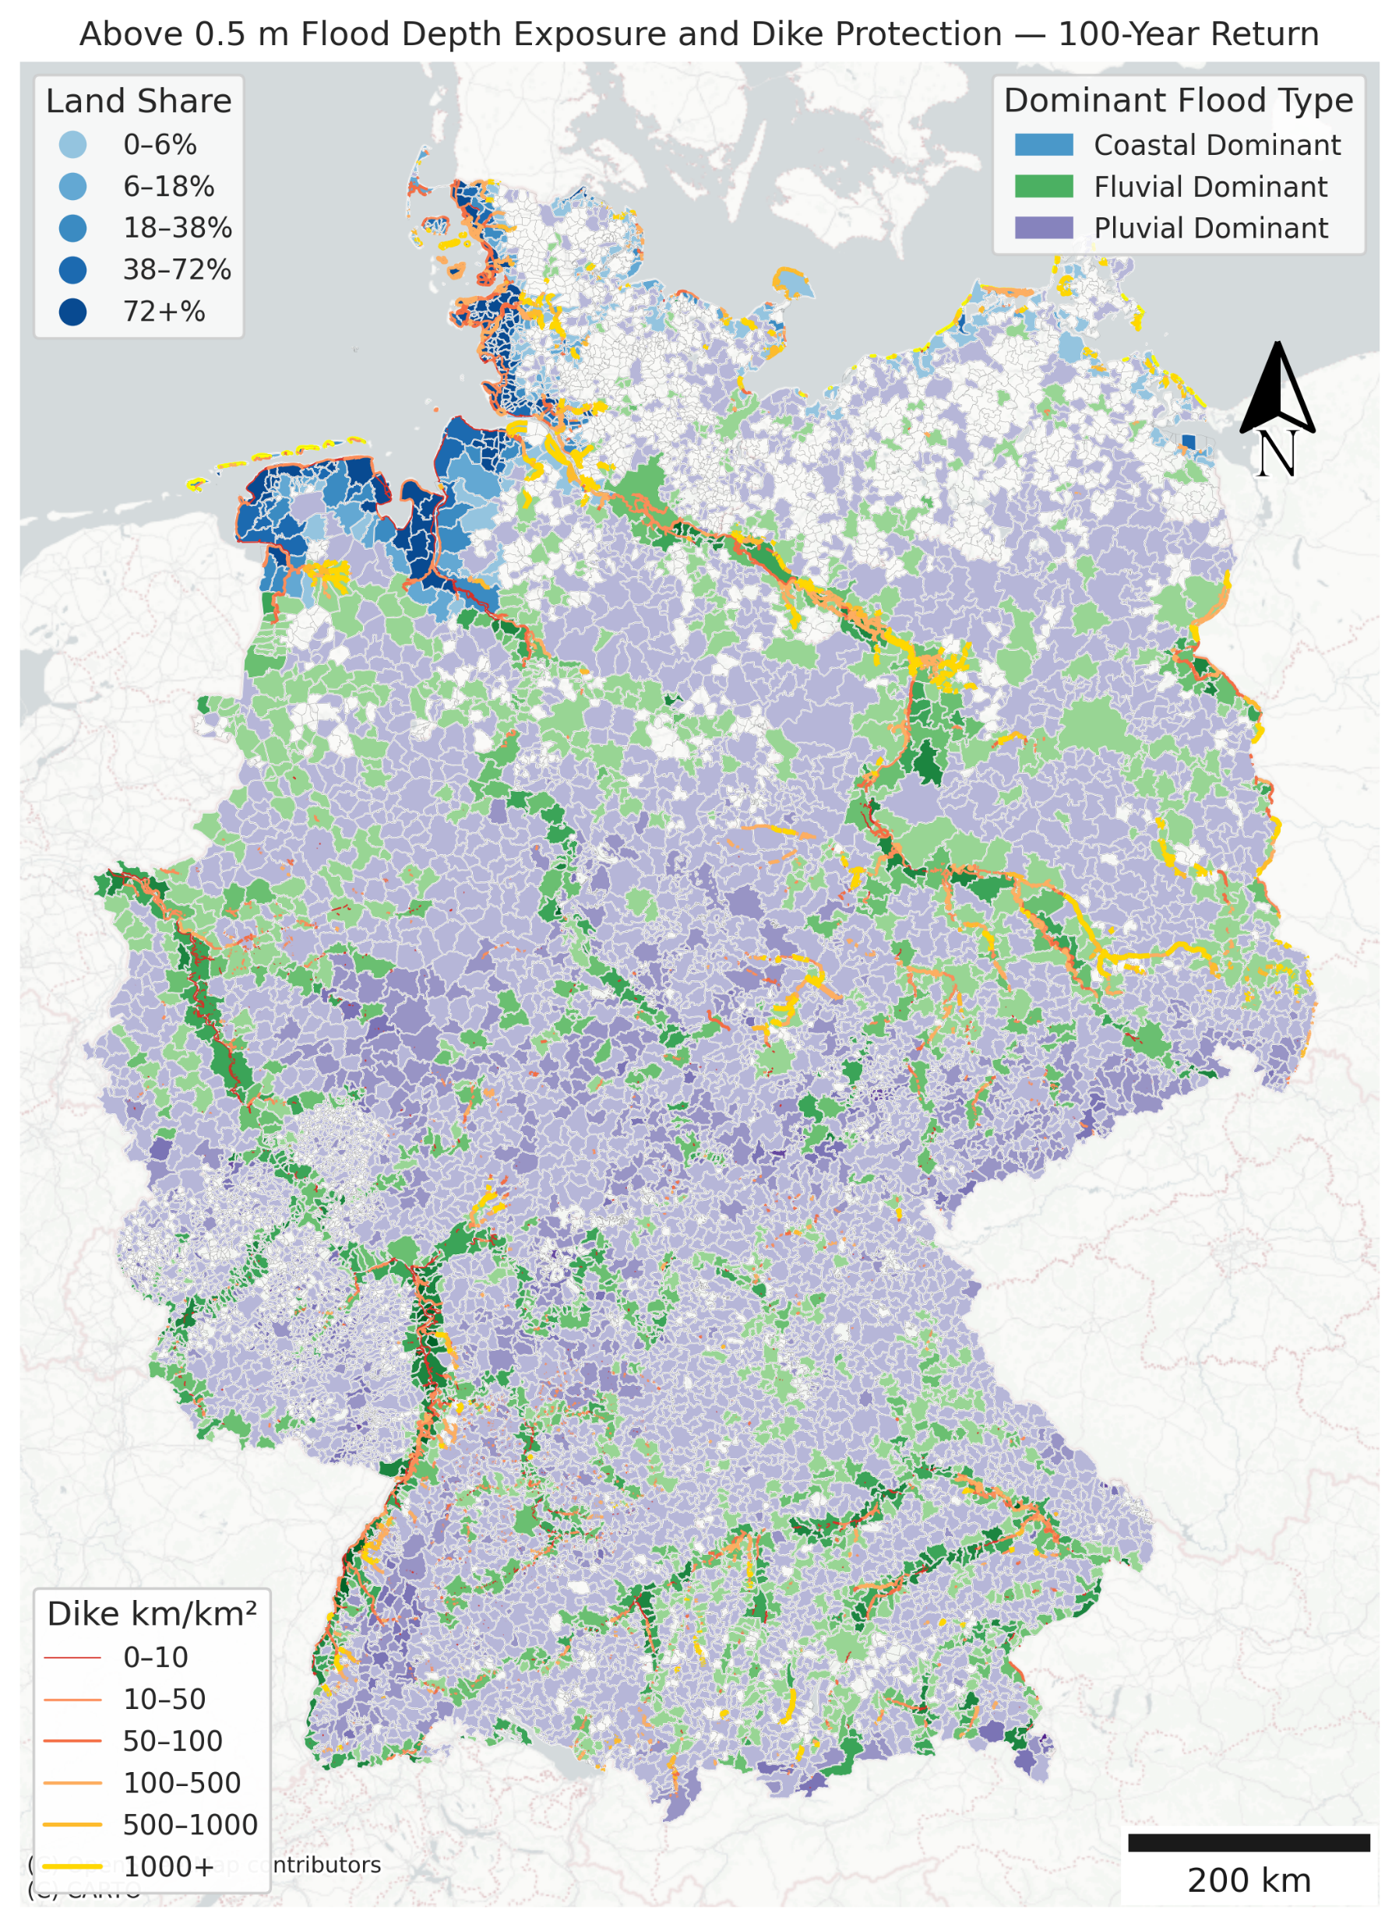
Total length of currently constructed dike = 13237.16 km

Slide 13
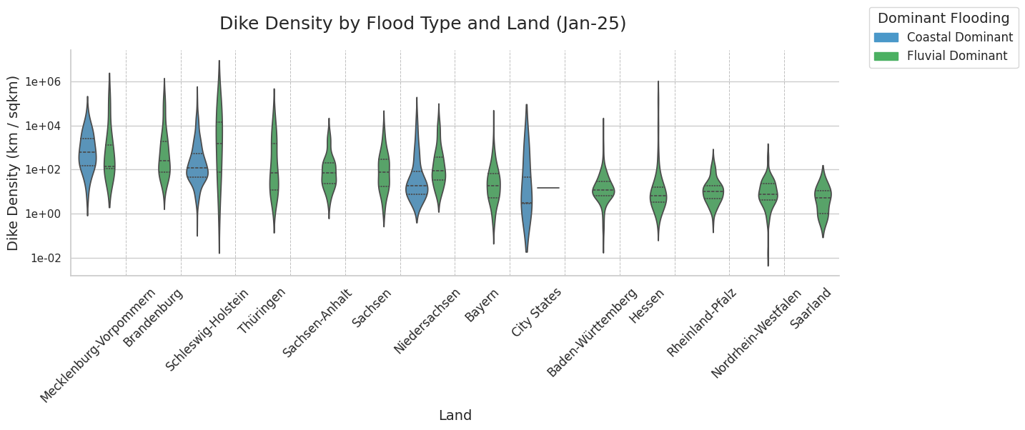
City State: Bremen, Berlin, Hamburg

Slide 14
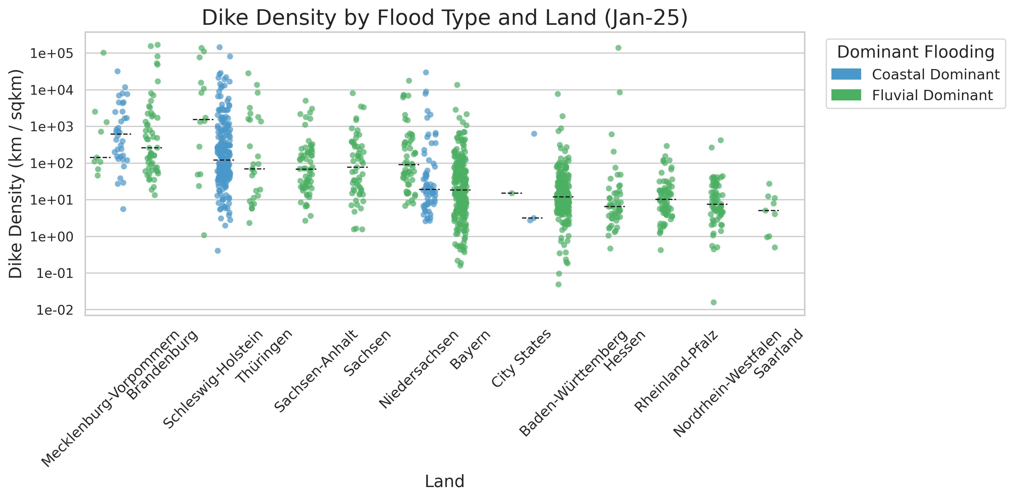
Will test manually adding 75 and 90 percentile line soon

Slide 15
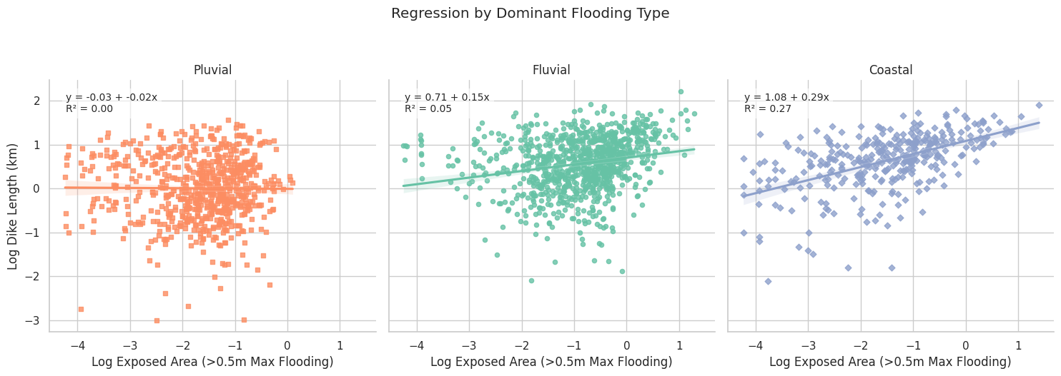

Slide 16
Summary of all Gemeinden included:
Flood Type | Total Exposed Area (sq km)
Coastal (CU) | 152.6109
Fluvial (FU) | 655.7197
Pluvial (PD) | 170.2653

Slide 17
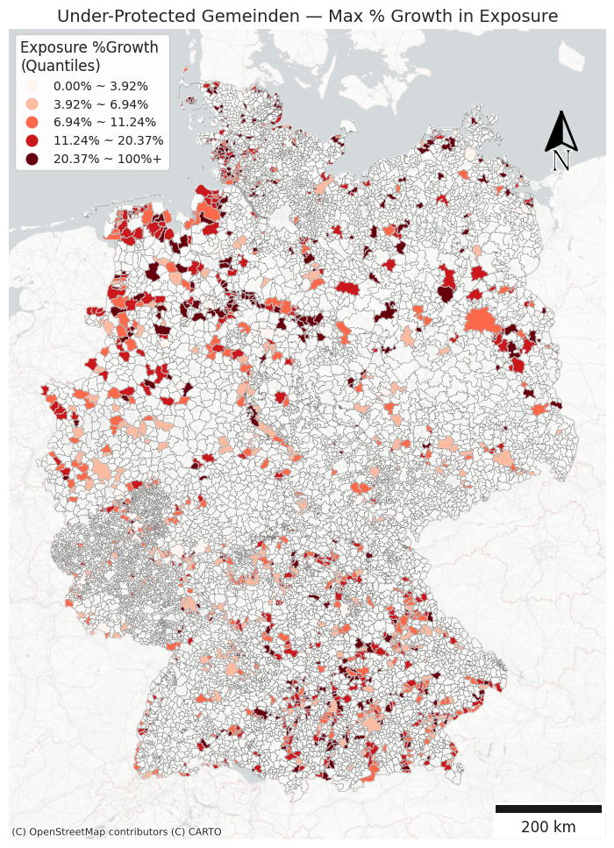
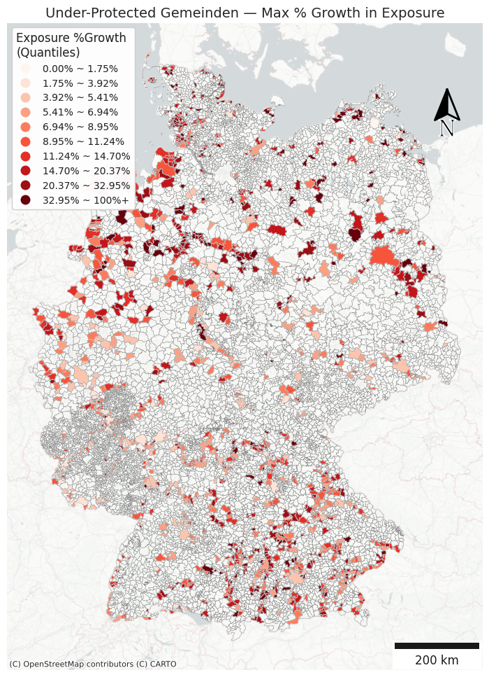
Are we going to use the 5 quantile breaks or customized breaks?
10 quantile breaks may be too many?

Slide 18
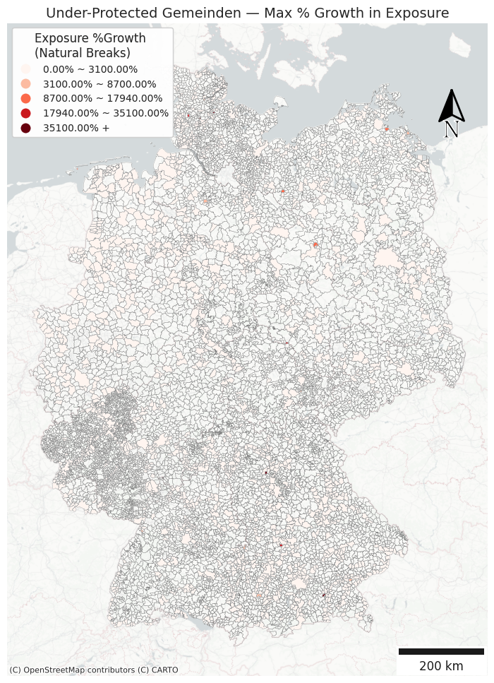
Natural Breaks doesn’t work well for this map…

Slide 19
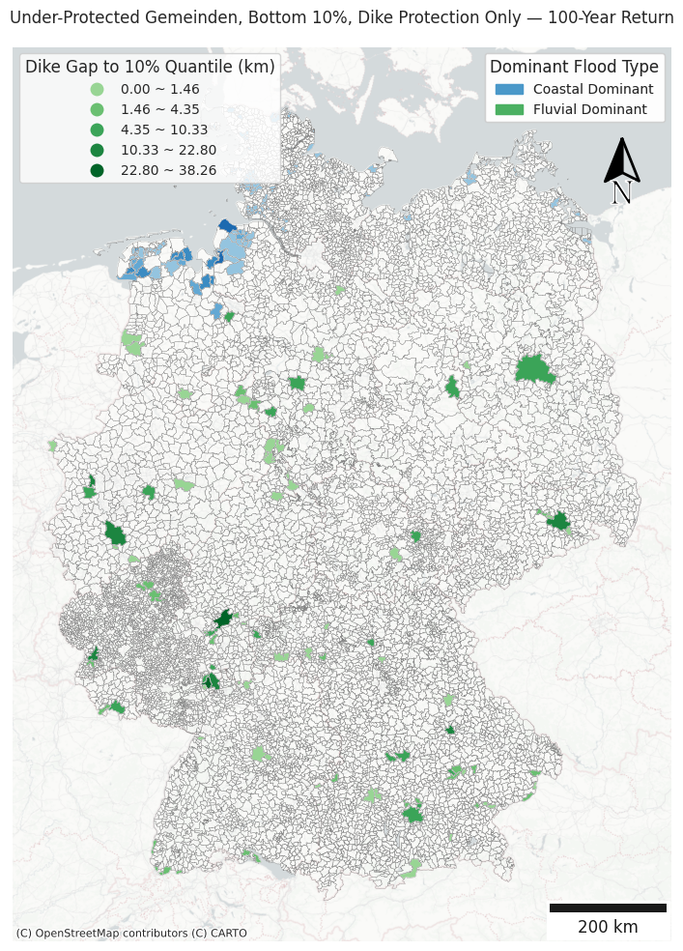
Sum of Dike Length needed = 557.58 km

Slide 20
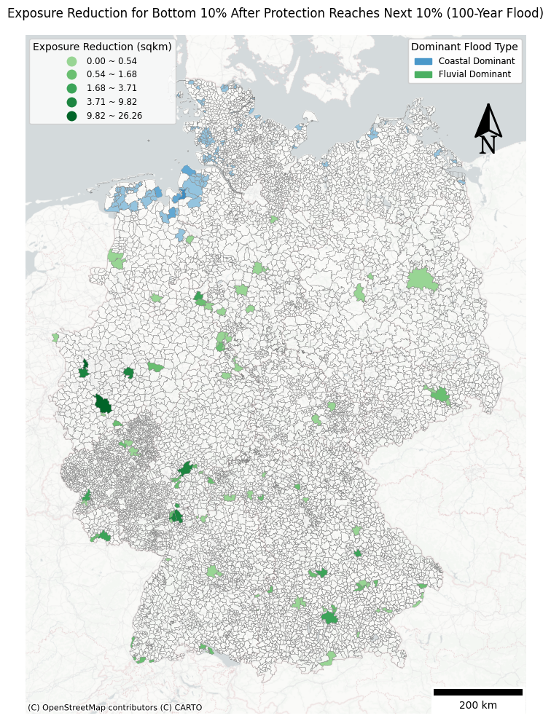
Sum of expected reduced exposure = 159.08 sqkm

Slide 21
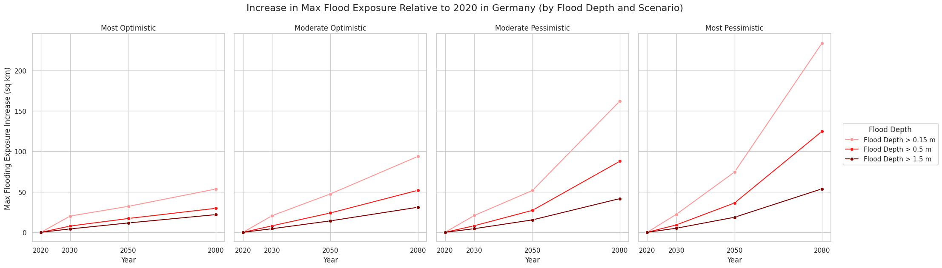

Slide 22
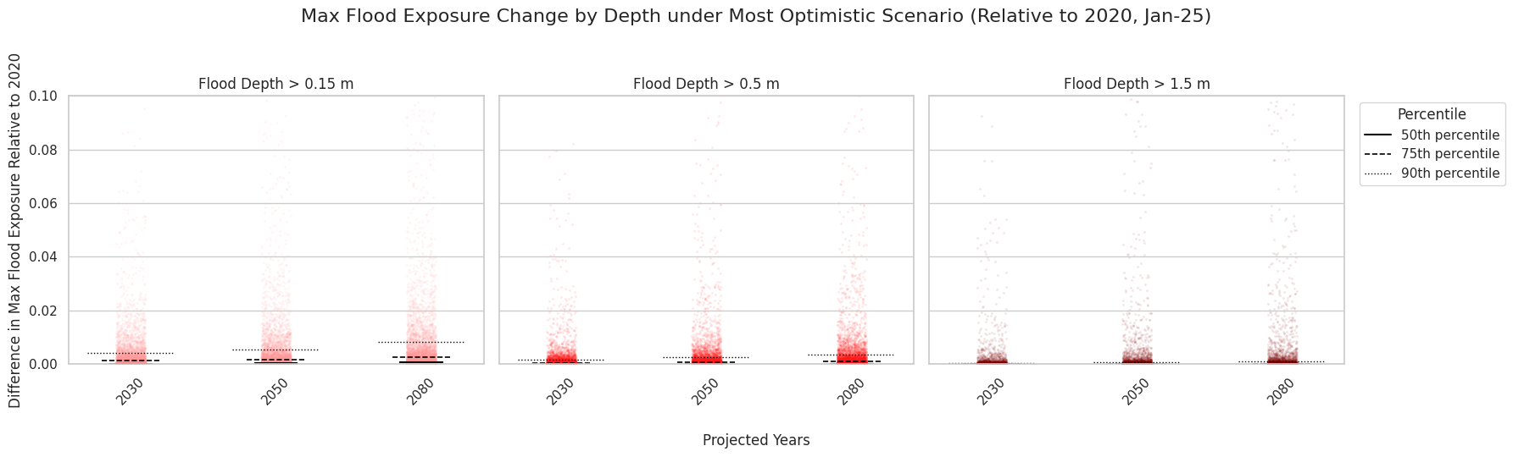
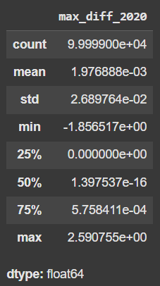
Number rounding issue and ylim to be updated
< 1% of the summed differences within the risk groups exceed 0.1 sq km.

Slide 23
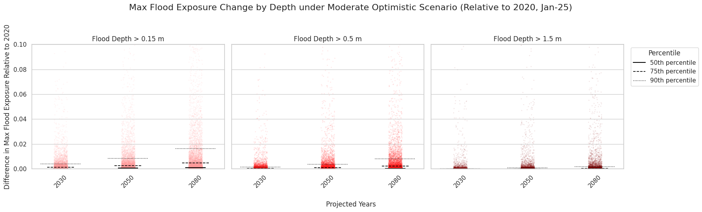
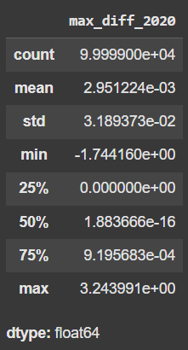
Number rounding issue and ylim to be updated
1% ~ 5% of the summed differences within the risk groups exceed 0.1 sq km.

Slide 24
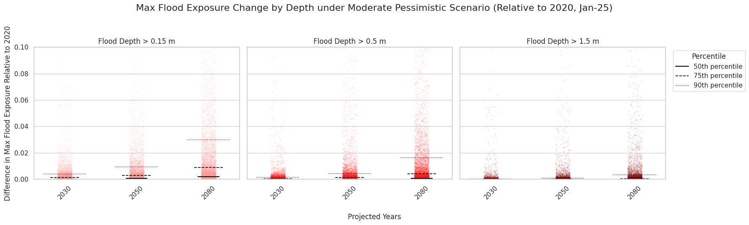
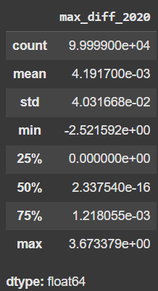
Number rounding issue and ylim to be updated
1% ~ 5% of the summed differences within the risk groups exceed 0.1 sq km.

Slide 25
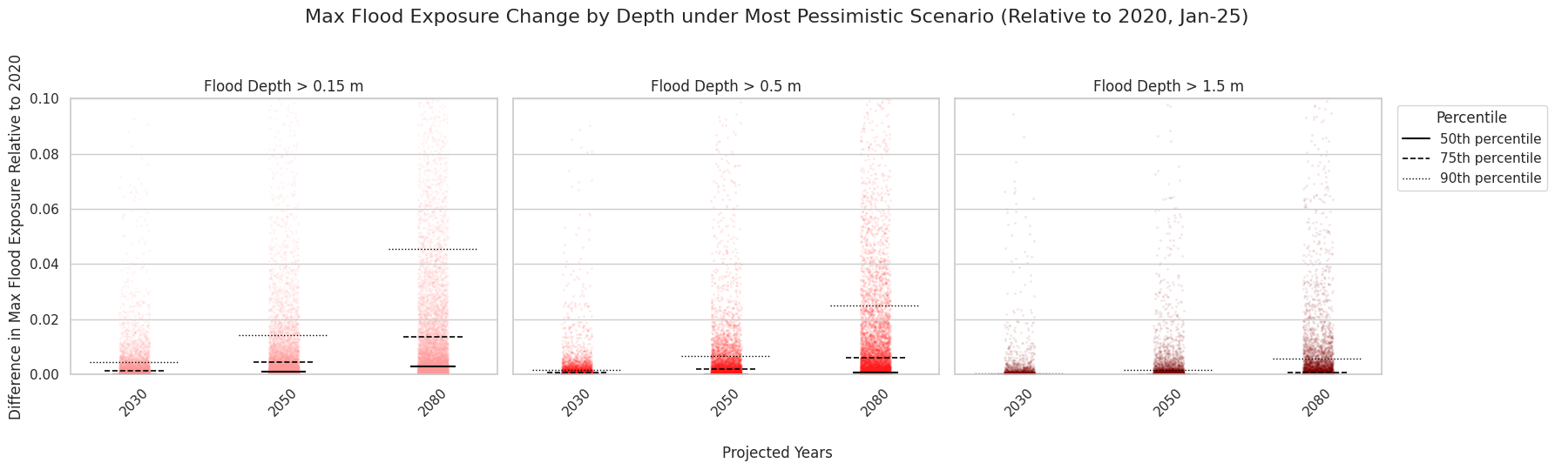
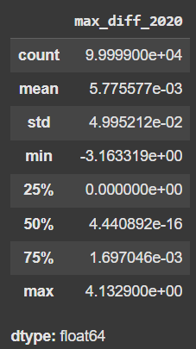
Number rounding issue and ylim to be updated
1% ~ 5% of the summed differences within the risk groups exceed 0.1 sq km.

